Slide 1




Hybrid Automata: From Verification to Implementation with HyST (A Source Transformation and Translation Tool for Hybrid Automaton Models)
DISTRIBUTION A. Approved for public release. Distribution unlimited. (Approval AFRL PA #88ABW-2015-1758, 07 Apr 2015)
Stanley Bak, Sergiy Bogomolov, Taylor T. Johnson
Contributors: Christian Schilling, Luan Viet Nguyen, Hoang-Dung Tran, Thomas Henzinger, Pradyot Prakash, Andrew Sogokon, Omar Beg, Ali Davoudi, Weiming Xiang, Shafiul Chowdhury
VeriVITAL - The Verification and Validation for Intelligent and Trustworthy Autonomy Laboratory (http://verivital.uta.edu/)
Department of Computer Science and Engineering
1
2
3
1
2
3
4
[Bak, Bogomolov, and Johnson, HSCC 2015]
[Nguyen, Schilling, Bogomolov, Johnson, RV 2015]
[Bak and Johnson, RTSS 2015]
[Bak, Bogomolov, Schilling, ARCH 2016]
[Bak, Bogomolov, Henzinger, Johnson, Prakash HSCC 2016]

Slide 2
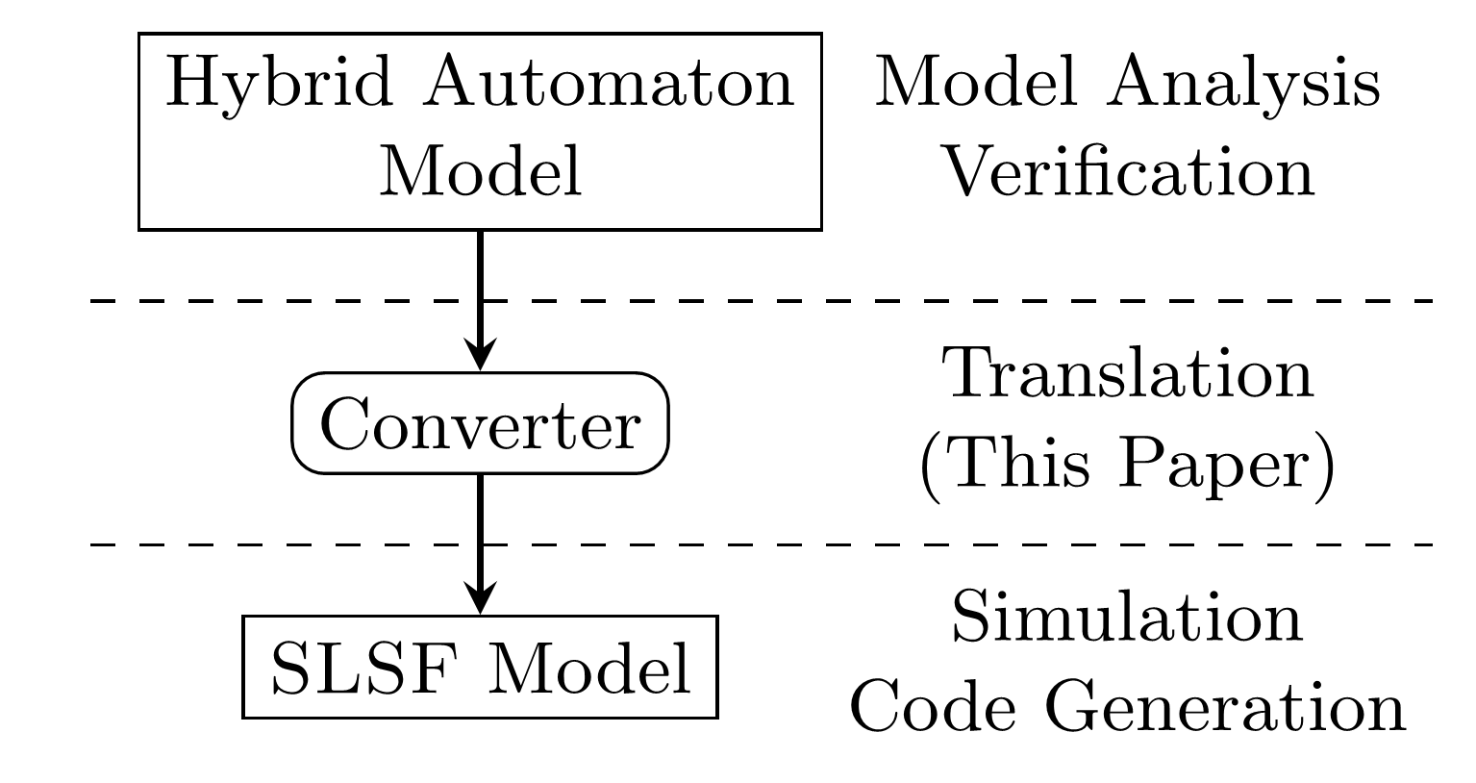
Motivation
SpaceEx XML
Significant recent progress in verifying properties for hybrid systems models, including implementations in software tools
SpaceEx, Flow*, dReach/dReal, HyComp (nuXmv), C2E2, …
Hybrid systems models are effective for modeling closed-loop control systems, composed of plant + controller (+ sensors/actuators…)
How can we leverage this progress to better integrate with typical control system development processes?
Translate hybrid automaton models to Simulink/Stateflow (SLSF) while preserving properties
Can then leverage existing code generators in Simulink/Stateflow
Assuming correctness of translation and code generation (and plant model validation / conformance / robustness), verified properties are preserved in actual system implementation
Technical challenges: semantics differences (non-determinism, urgency, no invariants in SLSF, floating point approximation of reals, etc.)
HyST Intermediate Representation (IR)
(Networks of hybrid automata)
Simulink/ Stateflow (SLSF)
Code Generation
Physical Plant and Actual Controller

Slide 3


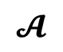
HyST: A Source Transformation and Translation Tool for Hybrid Automaton Models
Transformation passes:
Hybridization
Continuization
Order-reduction
Pseudo-invariants
…
$$𝓐$$
SpaceEx XML
$$P$$
Source-to-source transformation passes (IR to IR), such as abstractions
HyST Intermediate Representation (IR)
(Networks of hybrid automata)
Matlab, Python, and Java APIs
Benchmark Generators
Semantics Preserving Translation
Simulink/ Stateflow
dReach
Flow*
C2E2
HyComp
(nuXmv)
SpaceEx
SMT-LIB
…
Additional tool support being added by other research groups (KeYmaera-X at CMU, KSU, UConn, Illinois, …), and benchmarks through CPSWeek ARCH workshop
http://verivital.com/hyst/
https://github.com/verivital/hyst
[Bak, Bogomolov, Johnson, HSCC 2015]
Notes:
QBMC: Quantified bounded model checking for rectangular Hybrid Automata

Slide 4
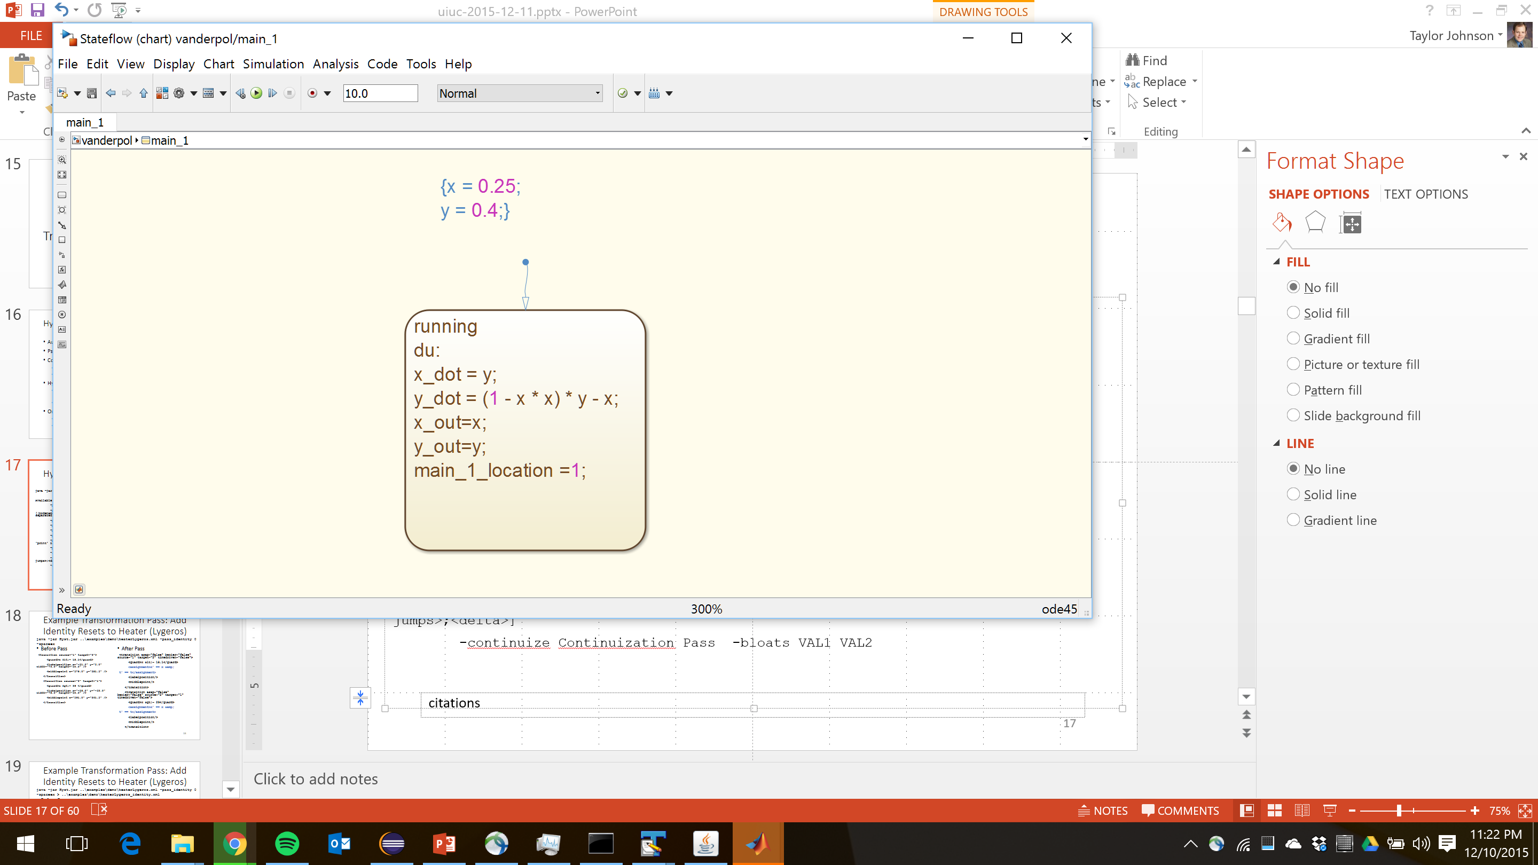
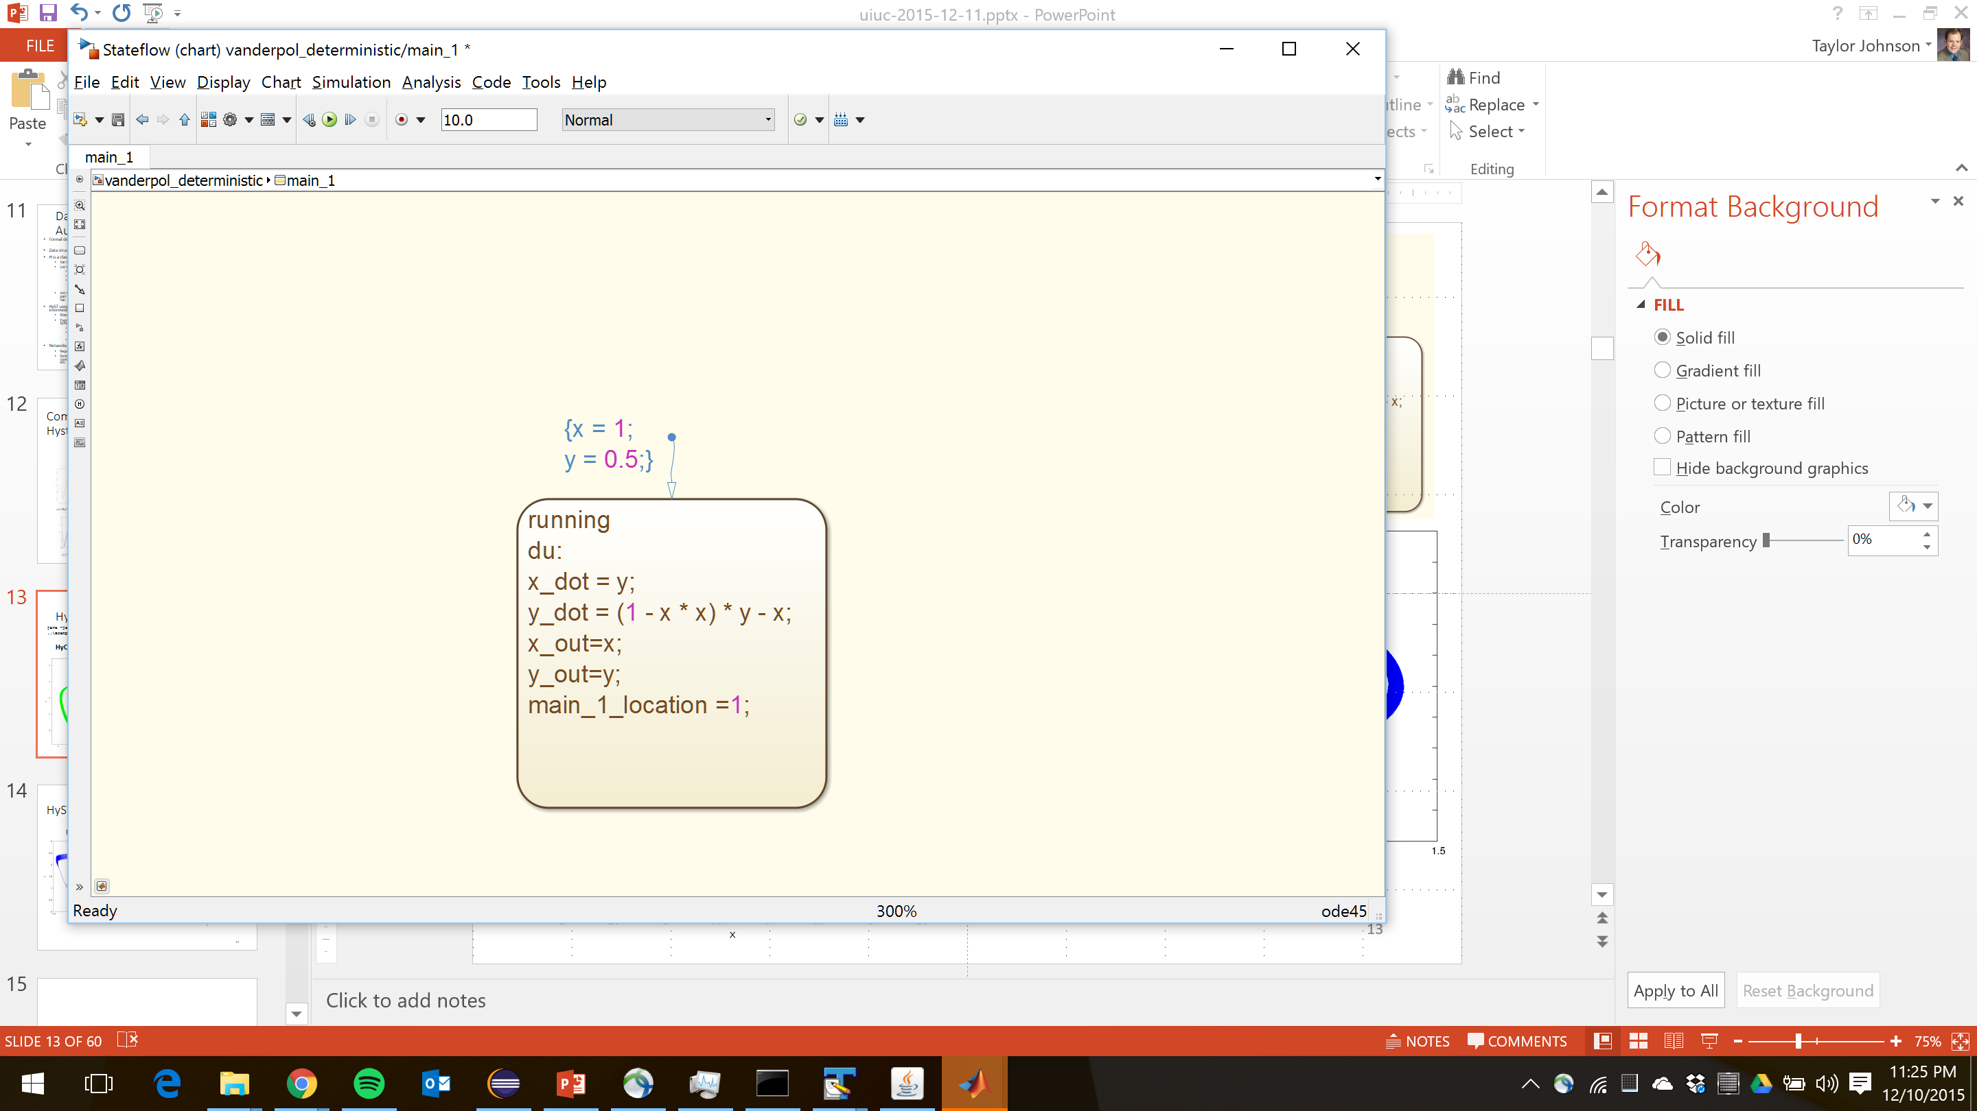
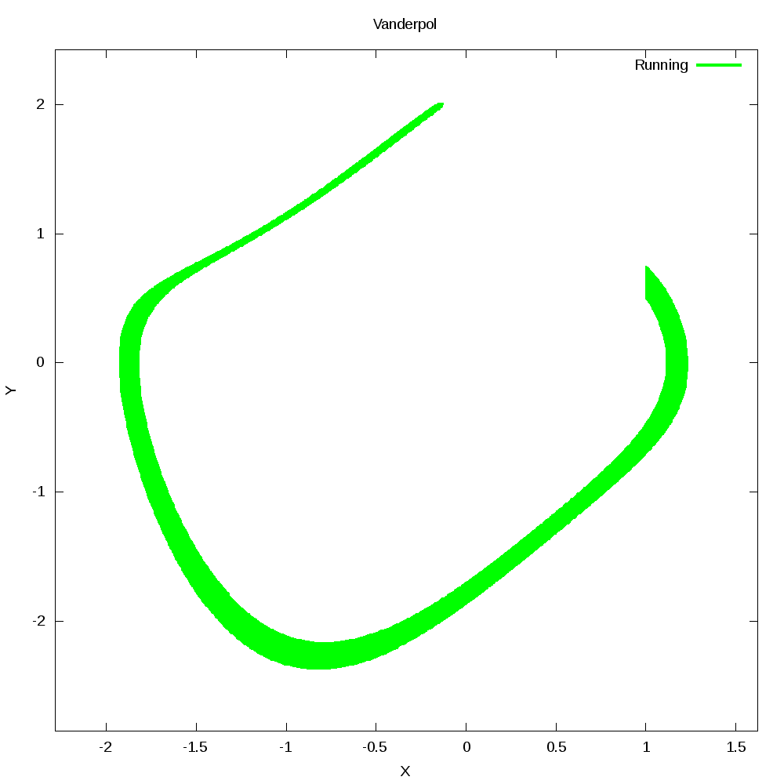
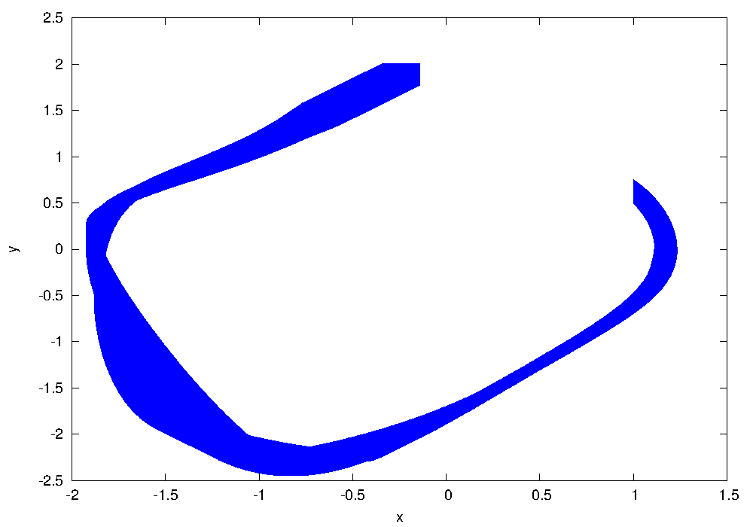
HyST Van Der Pol Example
java -jar Hyst.jar ..\examples\demo\vanderpol_deterministic.xml -stateflow
HyCreate
Flow*

Slide 5
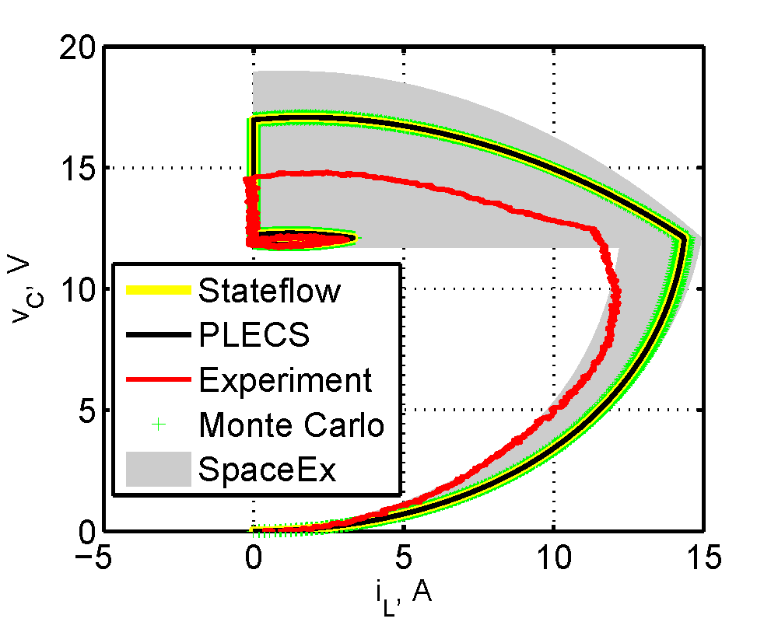
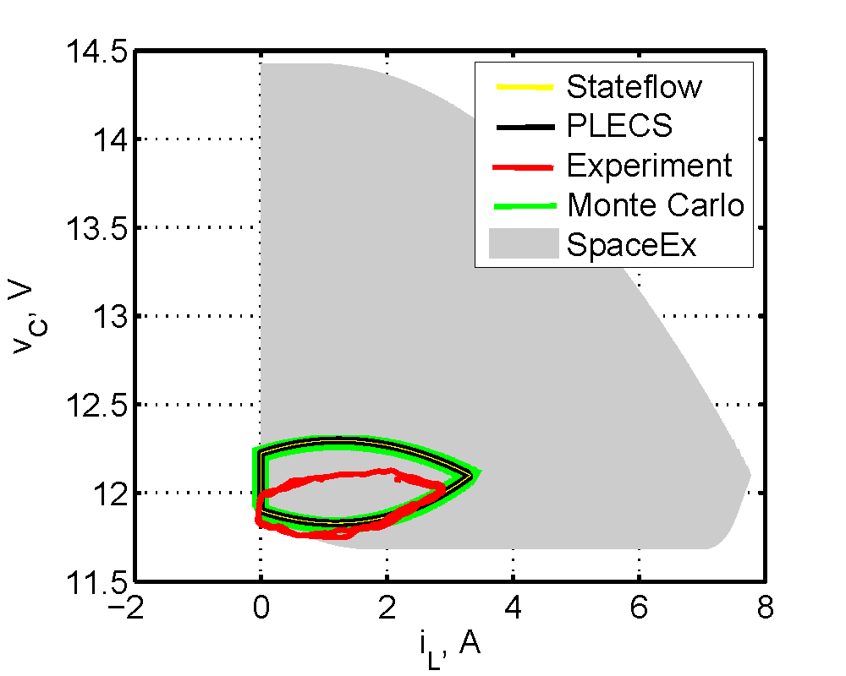
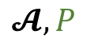
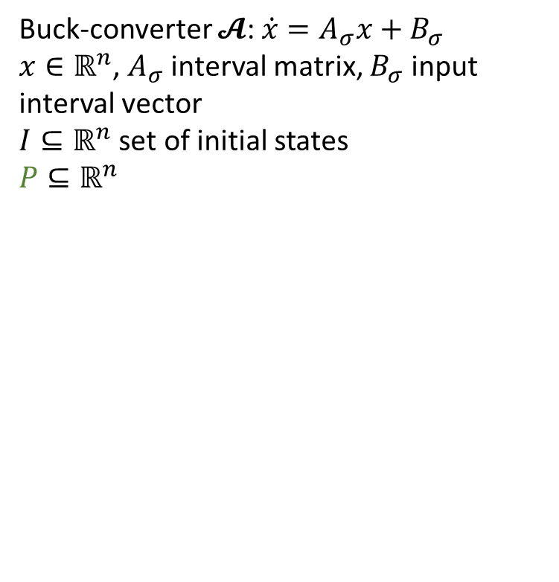
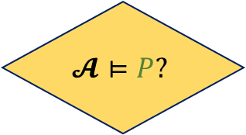
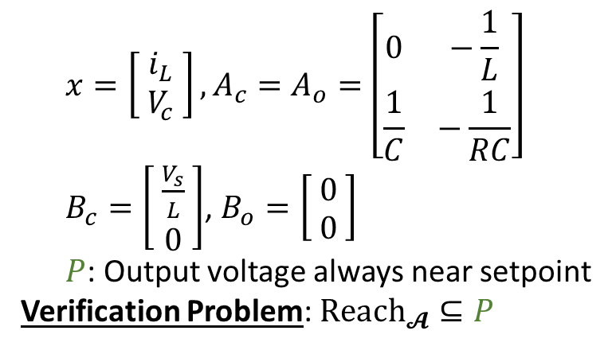
Reachability Analysis of Power Electronics with Non-Deterministic Parameters
$$x=\left[ \begin{aligned}i_{L} \\ V_{c}\end{aligned} \right],A_{c}=A_{o}=\left[\begin{matrix}0 & −\frac{1}{L} \\ \frac{1}{C} & −\frac{1}{RC}\end{matrix}\right]$$
$B_{c}=\left[ \begin{aligned}\frac{V_{s}}{L} \\ 0\end{aligned} \right]$, $B_{o}=\left[ \begin{aligned}0 \\ 0\end{aligned} \right]$
$P$: Output voltage always near setpoint
Verification Problem: $Reach_{𝓐}⊆P$
Buck-converter $𝓐$: $\dot{x}=A_{σ}x+B_{σ}$
$x∈ℝ^{n}$, $A_{σ}$ interval matrix, $B_{σ}$ input interval vector
$I⊆ℝ^{n}$ set of initial states
$$P⊆ℝ^{n}$$
$$𝓐, P$$
Startup
Steady State
$$𝓐⊨P?$$
No: bug
Yes: proof
Reachability computation reached fixed point: unbounded time verification
Joint work with Ali Davoudi and Omar Beg

Slide 6
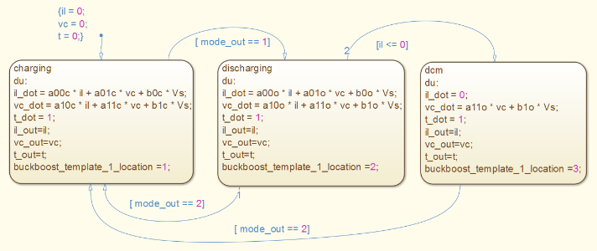
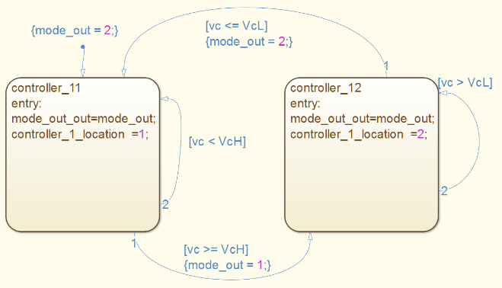
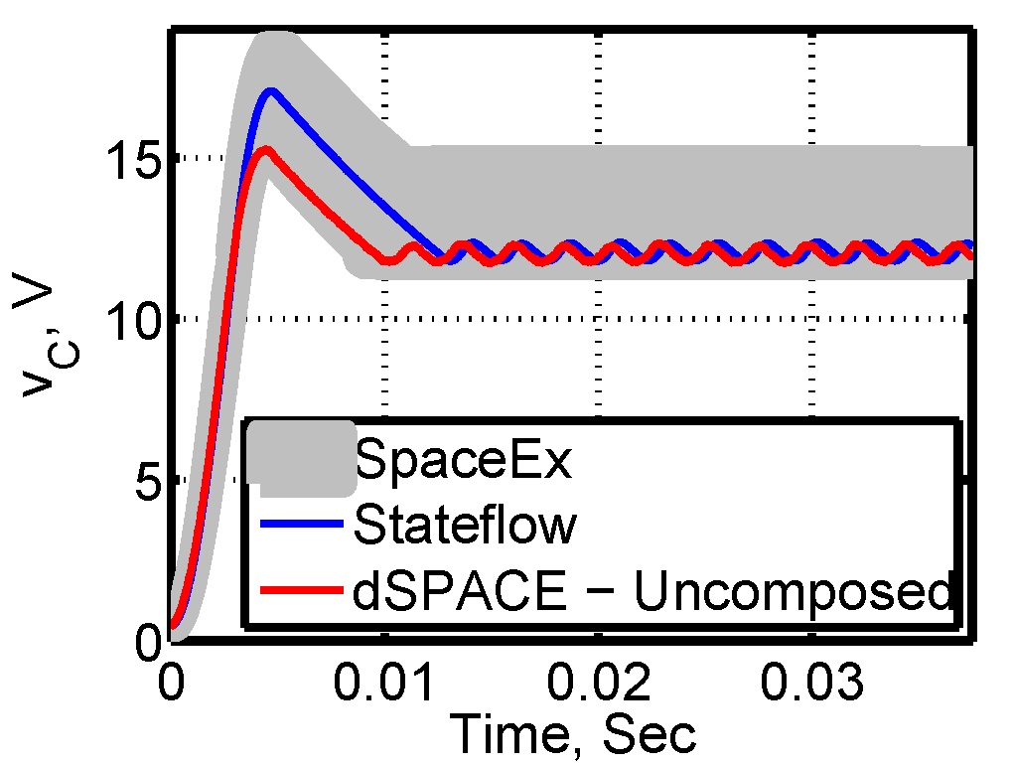
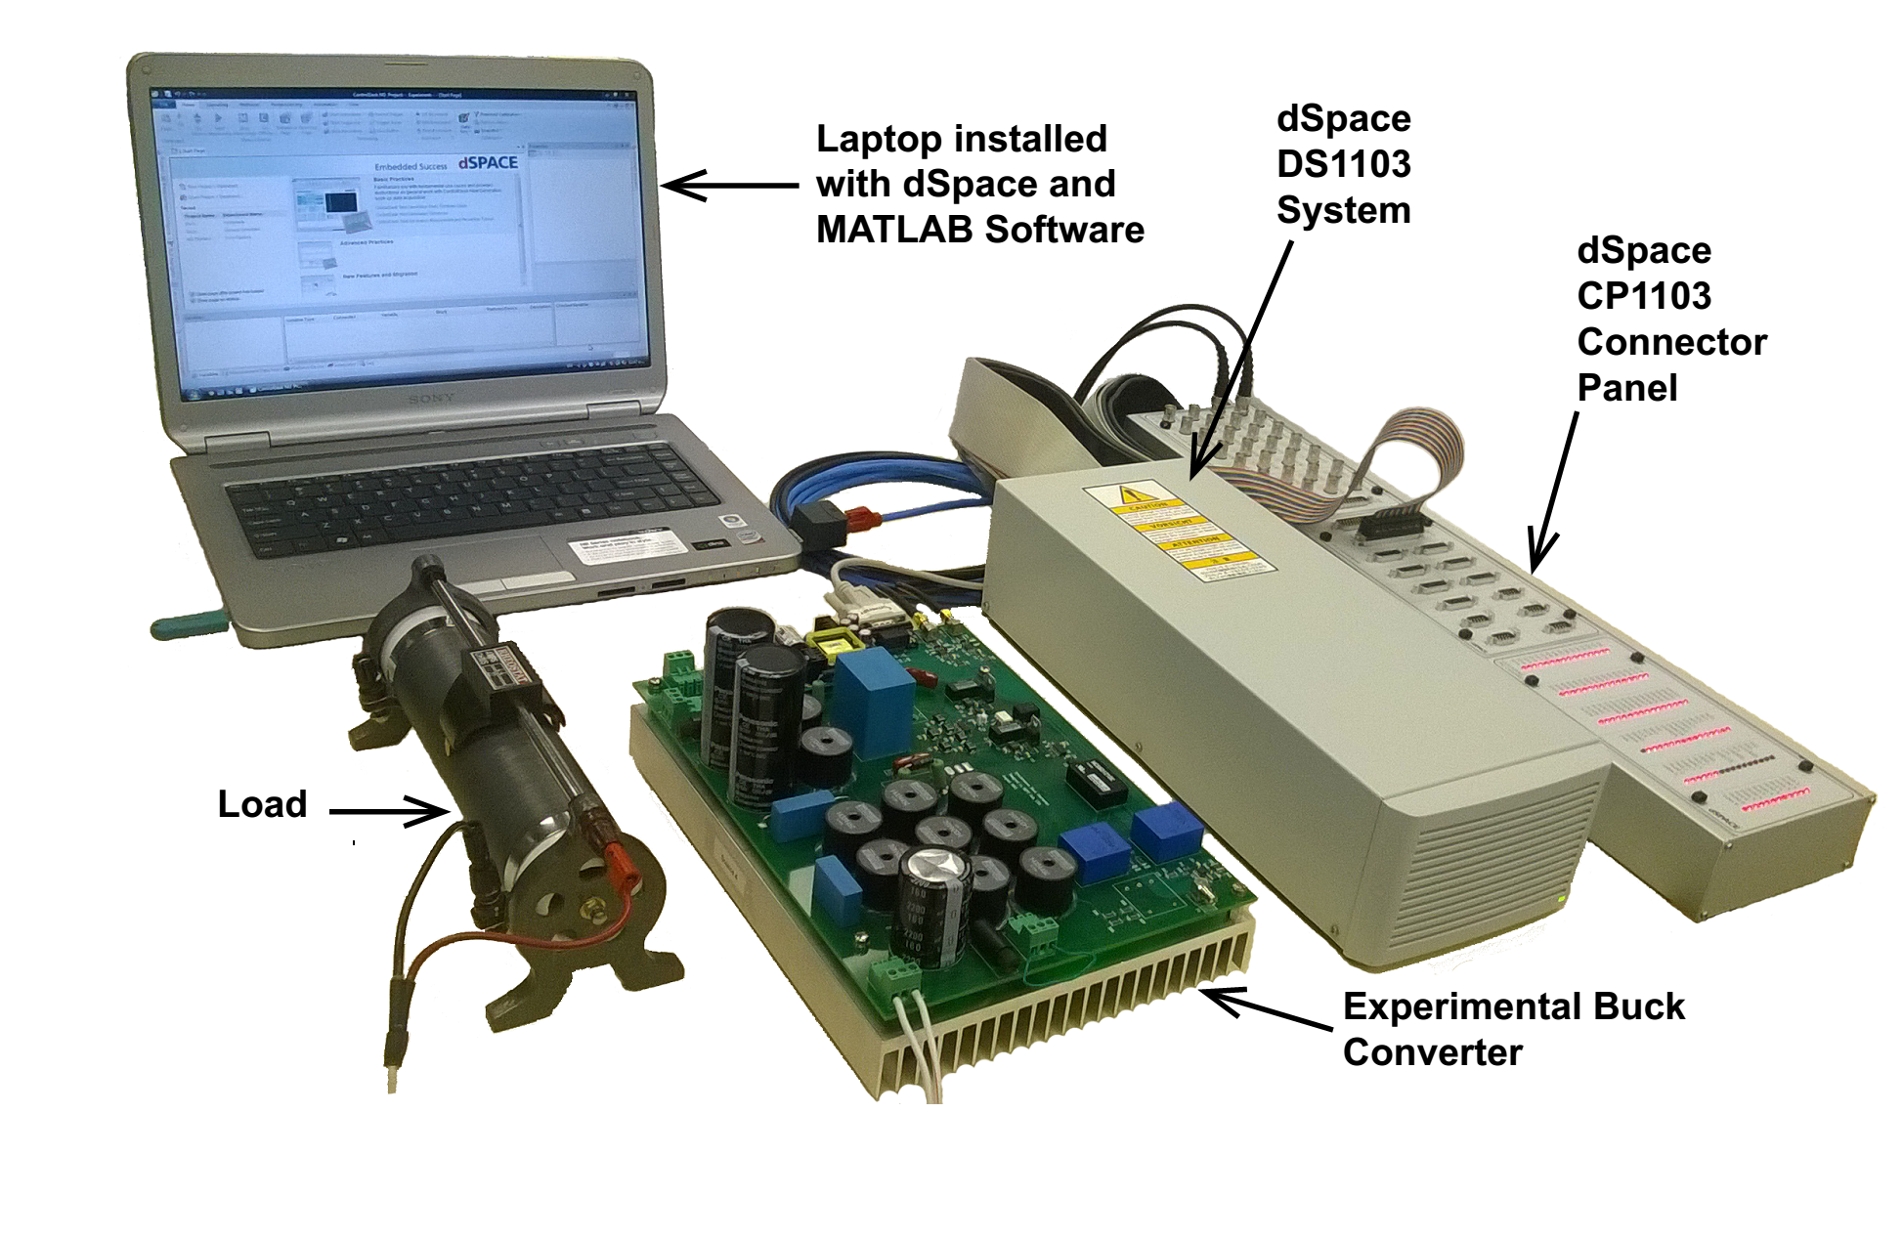
Correct-by-Construction Controller Design and Simulink/Stateflow Integration with HyST
SpaceEx XML
$$𝓐=H||C⊨P$$
Plant (Hybrid Automaton), H
$$\hat{𝓐}=\hat{H}||\hat{C}⊨\hat{P}$$
HyST Intermediate Representation (IR)
(Networks of hybrid automata)
Controller
(Purely Discrete Automaton or Timed Automaton), C
Simulink/ Stateflow (SLSF)
Code Generation
$$H||C$$
Physical Plant and Actual Controller
$$\hat{H}||\hat{C}$$

Slide 7
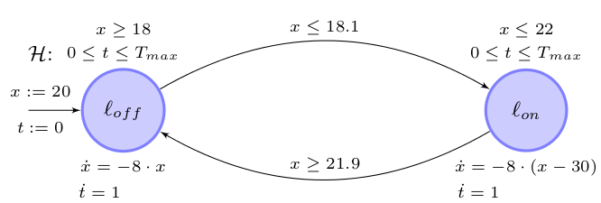
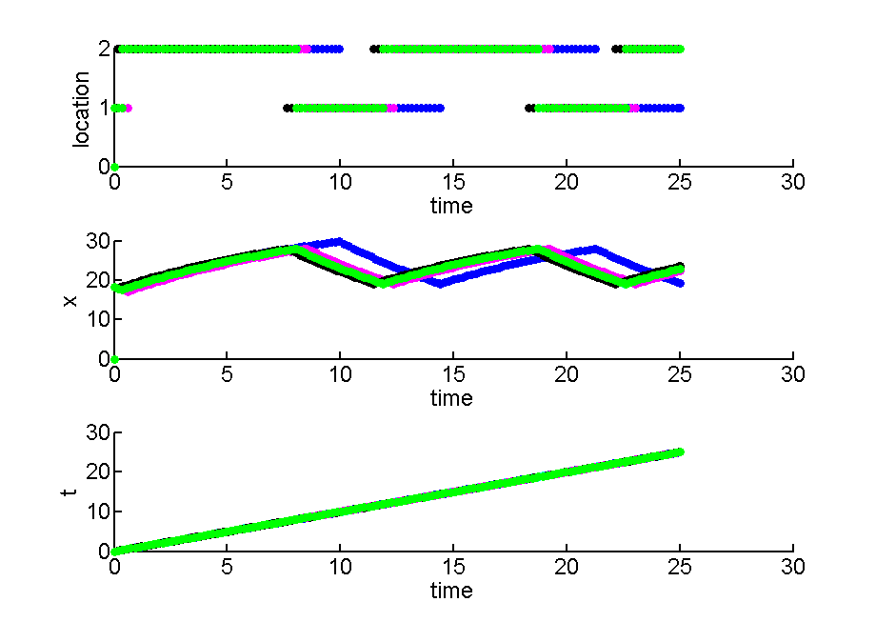
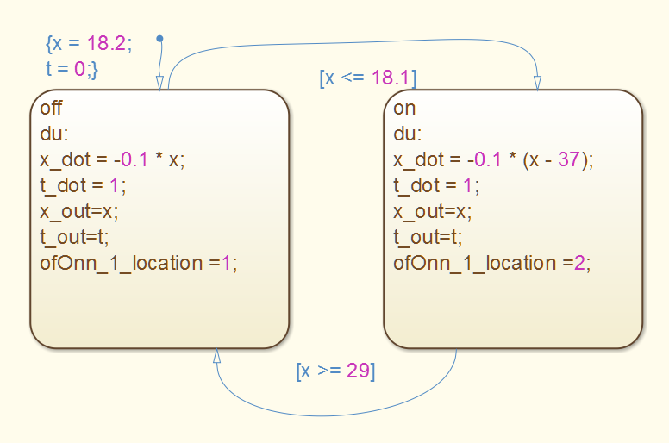
Approximating Hybrid Automaton Semantics in SLSF with Randomness
java -jar Hyst.jar ..\examples\demo\heaterLygeros.xml -stateflow -toolparams semantics=1
simulationLoop('heaterLygeros', 5, 25, 10, 1, {}, 1, 1);

Slide 8
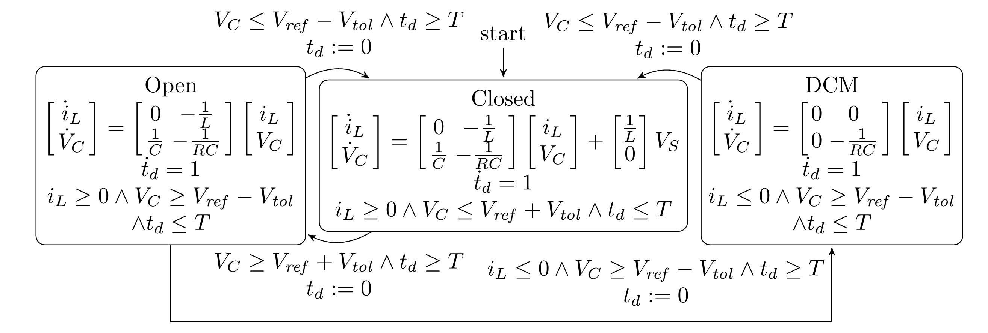
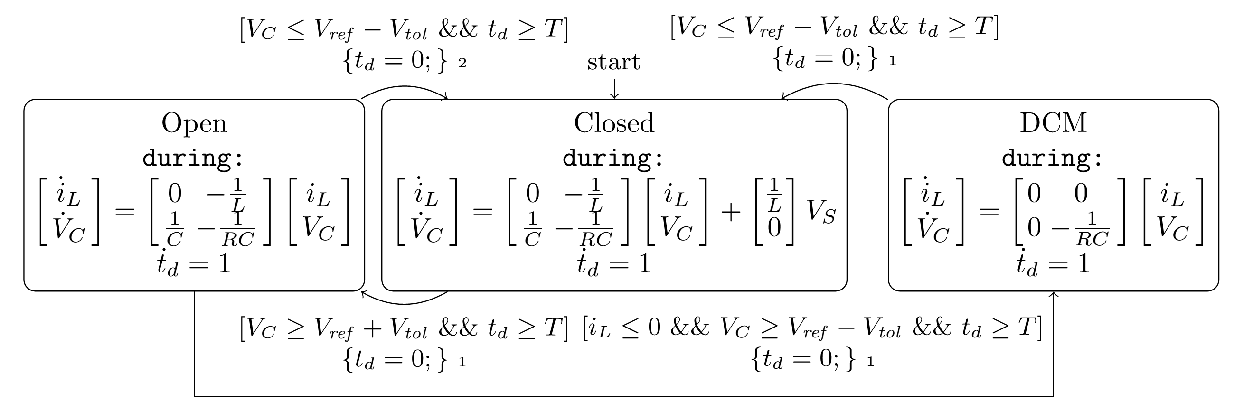
Composed Hybrid Automaton Model of Closed-Loop Buck Converter and Translated SLSF Model

Slide 9
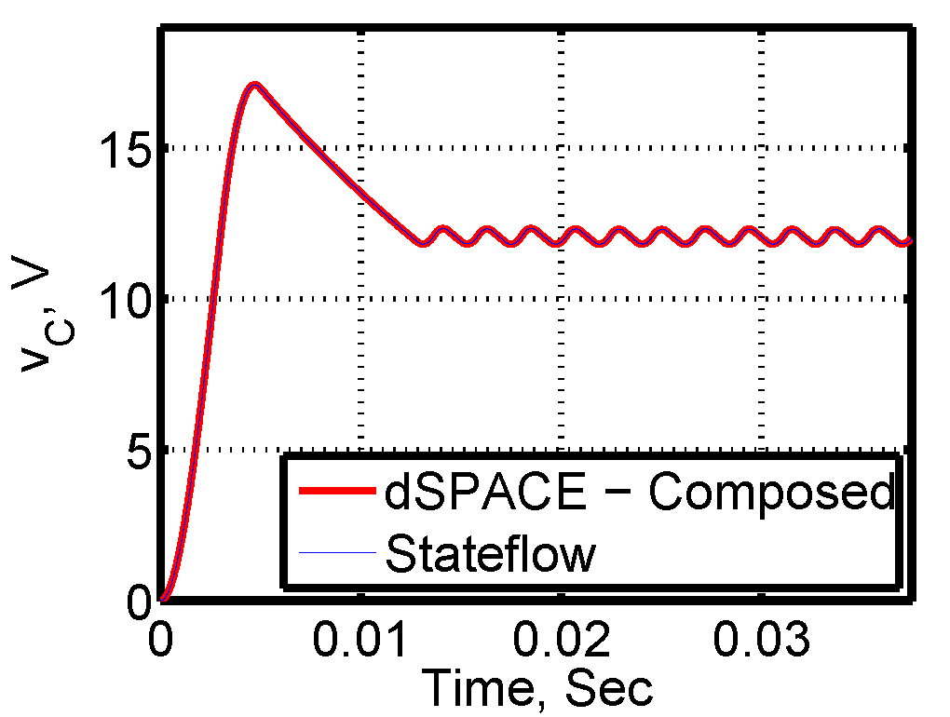
Code Generation from Hybrid Automata Translated to Simulink/Stateflow
Buck converter: hardware in the loop simulation
Buck converter: controller executed on dSpace hardware with actual buck converter plant

Slide 10
References
http://www.verivital.com/hyst/
https://github.com/verivital/hyst
Stanley Bak, Sergiy Bogomolov, Thomas A. Henzinger, Taylor T. Johnson, Pradyot Prakash, "Scalable Static Hybridization Methods for Analysis of Nonlinear Systems", In 19th Intl. Conf. on Hybrid Systems: Computation and Control (HSCC 2016), ACM, 2016, April. (Best Repeatability Evaluation Award)
Stanley Bak, Sergiy Bogomolov, Christian Schilling, "High-level Hybrid Systems Analysis with Hypy", In 3rd Applied Verification for Continuous and Hybrid Systems Workshop (ARCH), 2016, April. (Best Tool Award)
Stanley Bak, Taylor T. Johnson, "Periodically-Scheduled Controller Analysis using Hybrid Systems Reachability and Continuization", In 36th IEEE Real-Time Systems Symposium (RTSS 2015), IEEE Computer Society, San Antonio, Texas, 2015, December
Luan Viet Nguyen, Christian Schilling, Sergiy Bogomolov, Taylor T. Johnson, "Runtime Verification of Model-based Development Environments", In 15th International Conference on Runtime Verification (RV 2015), Vienna, Austria, 2015, September.
Stanley Bak, Sergiy Bogomolov, Taylor T. Johnson, "HyST: A Source Transformation and Translation Tool for Hybrid Automaton Models", In 18th International Conference on Hybrid Systems: Computation and Control (HSCC 2015), ACM, Seattle, Washington, 2015, April

Slide 11





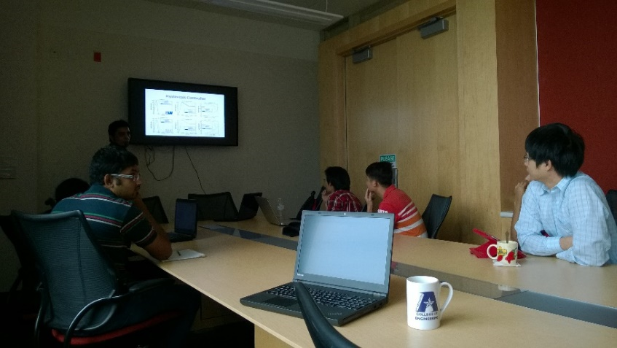
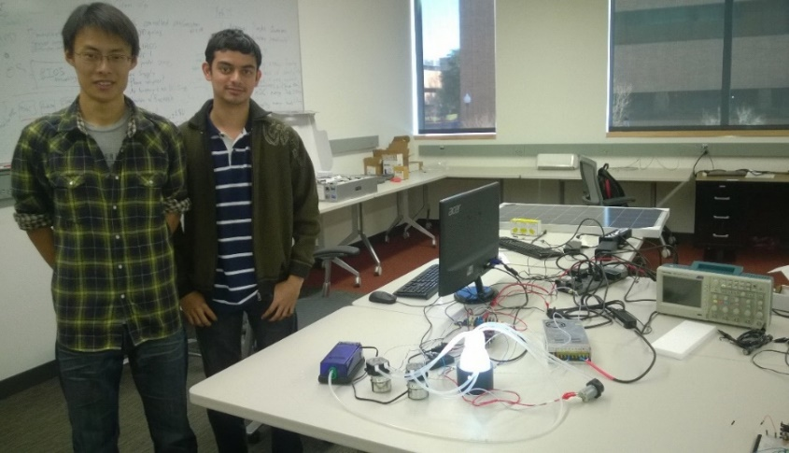
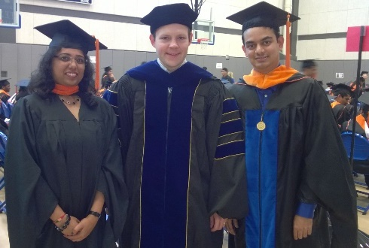
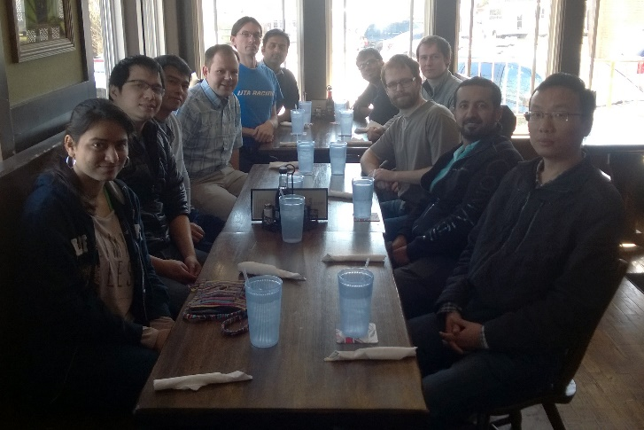
Thank You! Questions?
Acknowledgements
UTA CSE: Christoph Csallner (Assoc. Prof), Andrew Sogokon (Postdoc), Weiming Xiang (Postdoc), Khaza Hoque (Postdoc), Luan Viet Nguyen (PhD), Hoang-Dung Tran (PhD), Mousa Almotairi (PhD), Shafiul Chowdhury (PhD), Nathan Hervey (MSc)
UTA EE: Ali Davoudi (Asst. Prof), Omar Beg (PhD), Rahul Kawadgave (MSc), Randy Long (MSc)
AFRL: Stanley Bak, Steven Drager, R. Scott Erwin
Taylor T. Johnson
http://www.TaylorTJohnson.com/
http://verivital.uta.edu

Slide 13
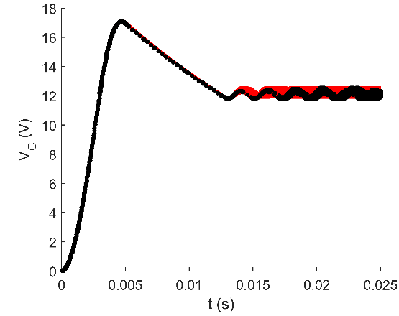
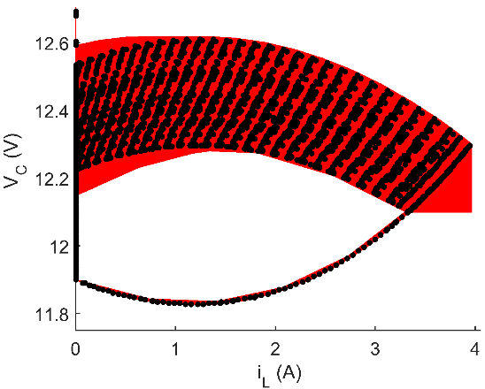
SLSF Translation of Buck Converter (Non-Deterministic Parameters) with Hysteresis Controller

Slide 14
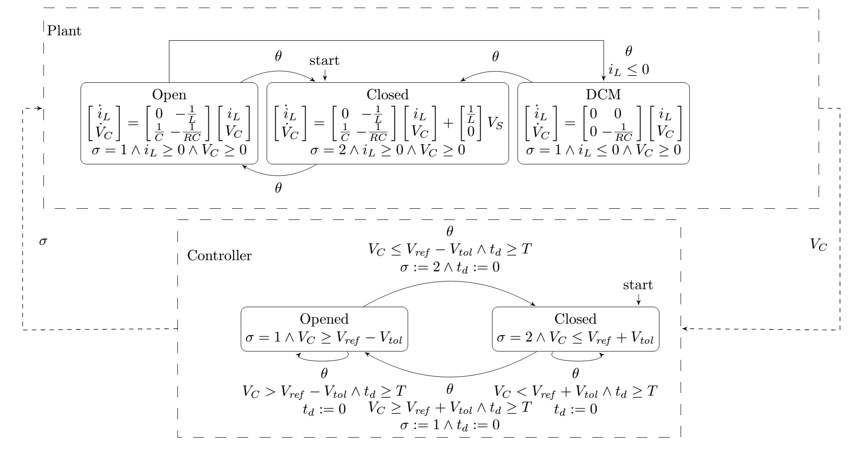
Closed-Loop Buck Converter Modeled as Network of Hybrid Automata

Slide 15
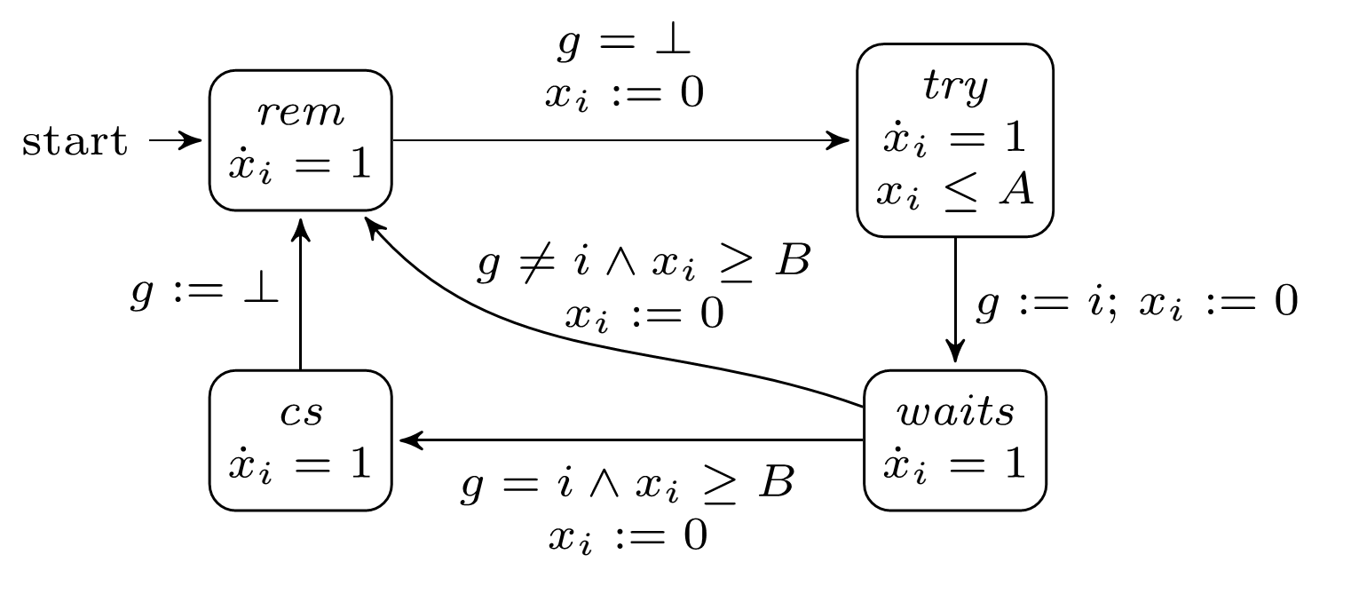
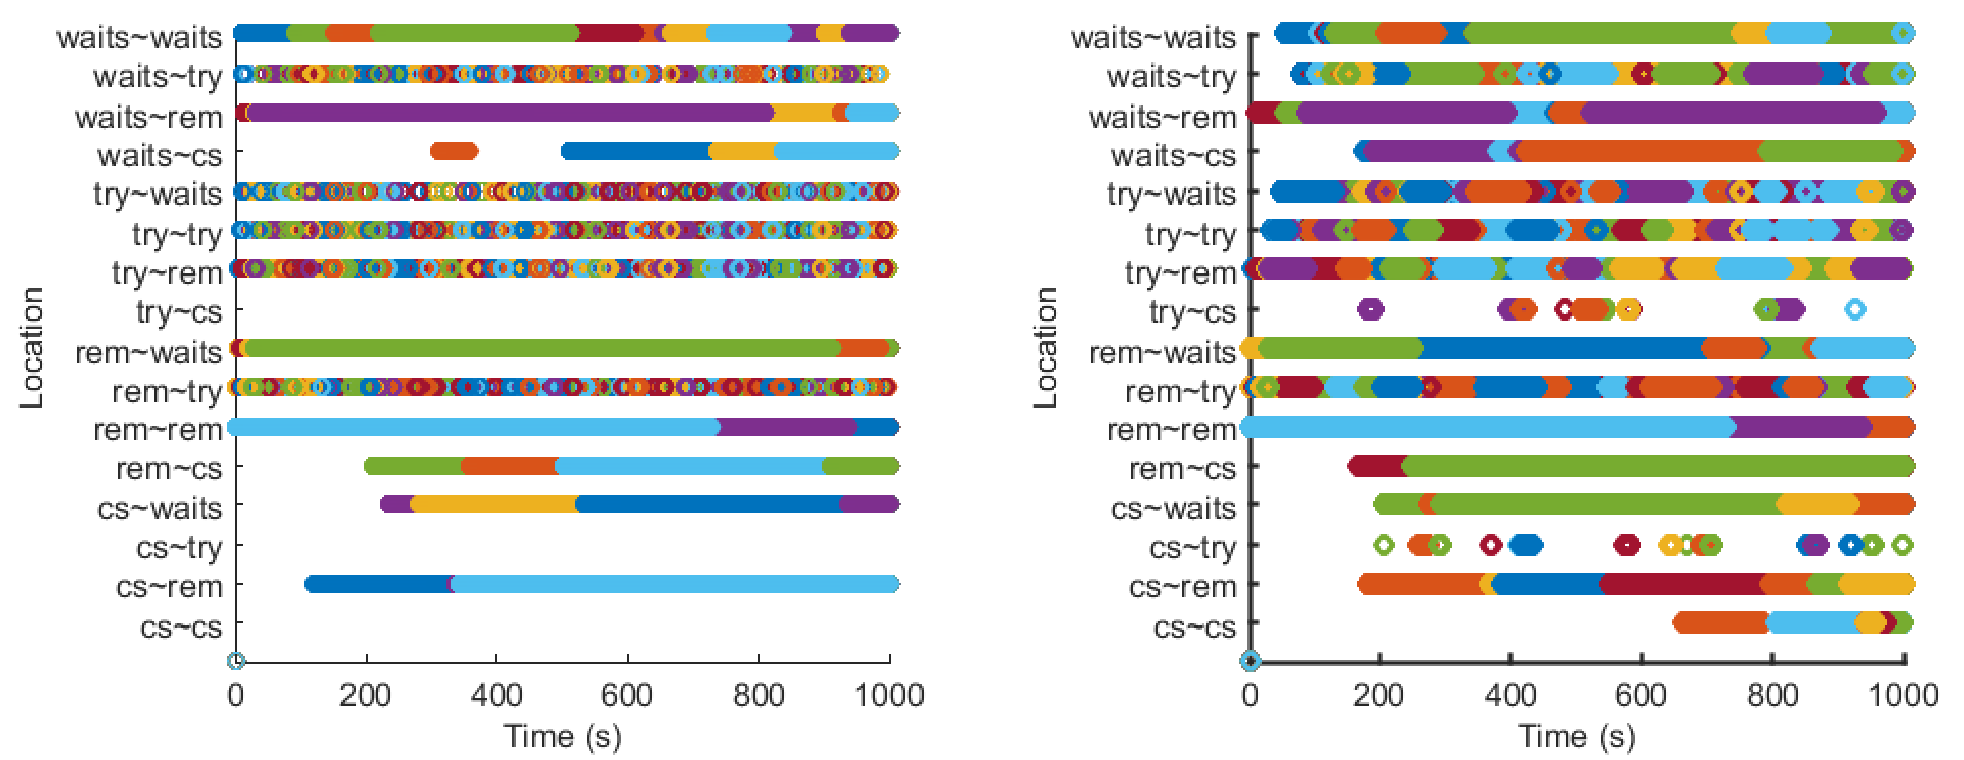
Fischer Mutual Exclusion (left safe, right unsafe), 1000 SLSF sim

Slide 16
HyST Vision
Community-driven approach: please help us support your tools!
We do not have bandwidth to support all the tools for the community
We will also eventually run into fine semantics issues we’ll have to discuss to resolve
Others are adding support: CMU’s KeYmaeraX, KSU’s tools (Beaver/AVERIST), XSpeed from India, C2E2 from UIUC, …
Many benefits to add your tools to HyST (LGPLv3)
https://github.com/verivital/hyst
Many benchmarks
Several popular verification tools already supported
Scripts to batch execute tools on benchmarks and parse verification results (HyPy)
Benchmark generators
Matlab APIs, Python APIs, Java interface
Eventually hope to get to SMT-LIB/llvm for hybrid systems
Building on other efforts (HSIF, CIF, …)

Slide 17
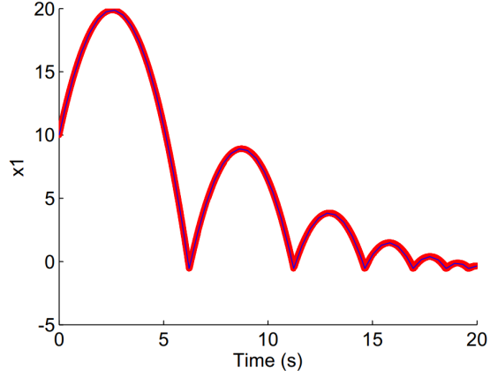
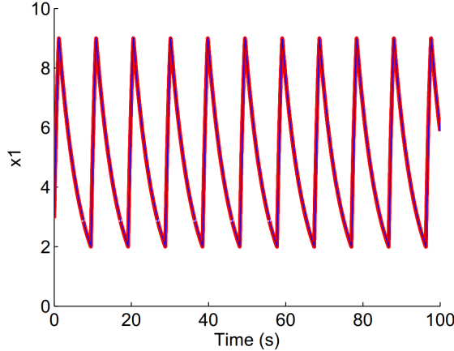
HyRG: A Random Generation Tool for Affine Hybrid Automata
SpaceEx’s LGG
SLSF
http://verivital.uta.edu/hyrg/
Notes:
Randomly generate sets of locations, continuous dynamics (flows), invariants, transition, guards, assignments, and initial conditions for hybrid automata
Rather than picking only random matrices and vectors for the affine functions used in flows, guards, invariants, assignments, etc., we instead partition these affine functions into classes.
All structural components of the automaton are selected randomly (i.e., the transitions and continuous dynamics), and are not simply parameters
The general method may be extended to nonlinear functions

Slide 18
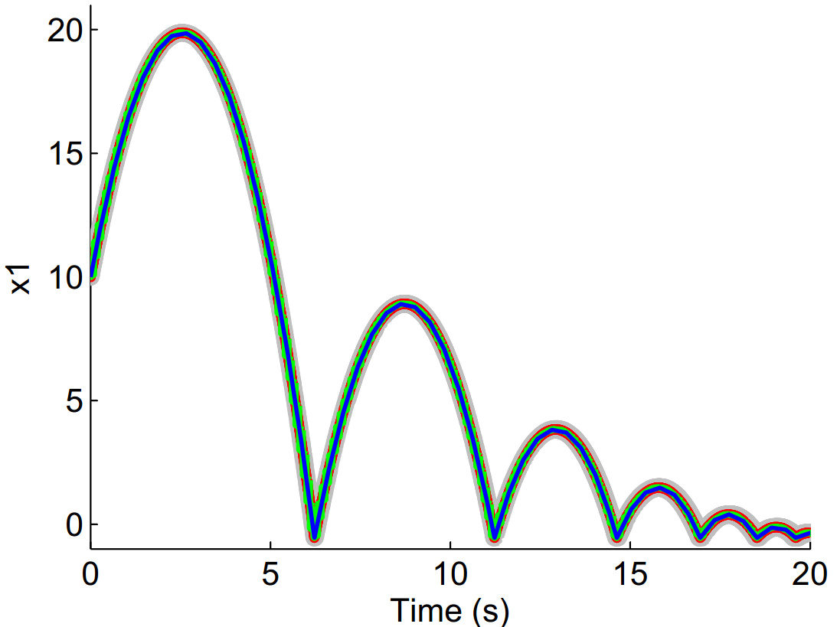
Bouncing Ball Comparison
SpaceEx’s LGG
SpaceEx's STC
Flow*
SLSF
reachCheck returns SAT

Slide 19
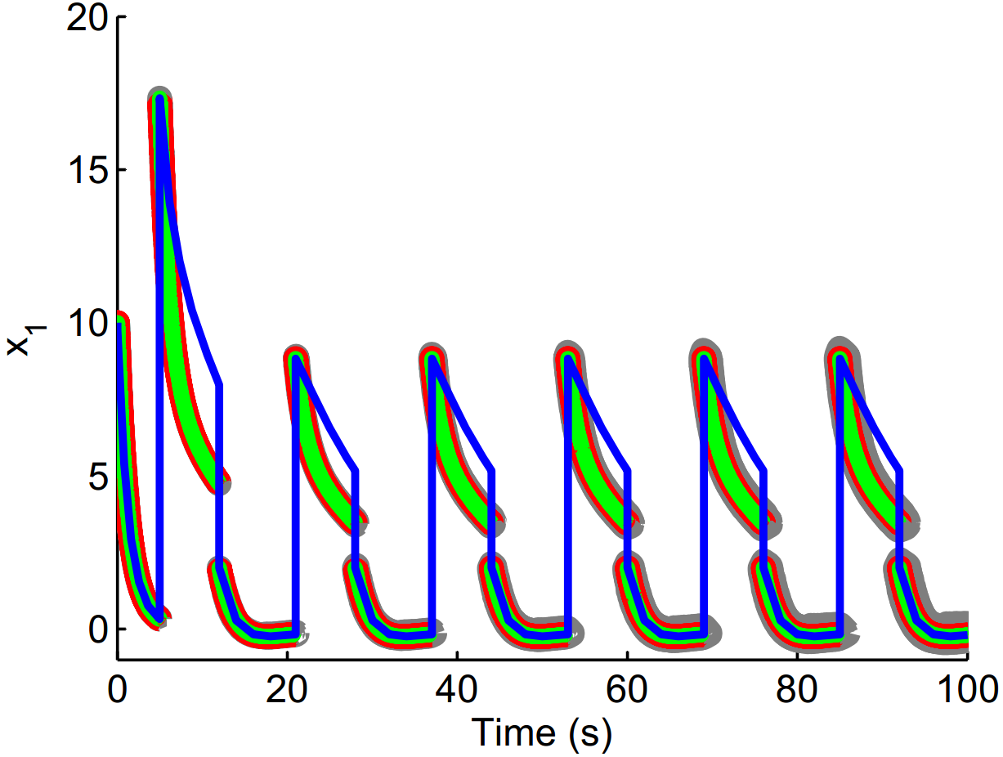
Finding Semantics Mismatches
SLSF uses sequential updates (x = 0; x’ = y; y’ = x + y => y’ = 2y) while hybrid automata use concurrent ones ( => y’ = y)
SpaceEx’s LGG
SpaceEx's STC
Flow*
SLSF

Slide 20
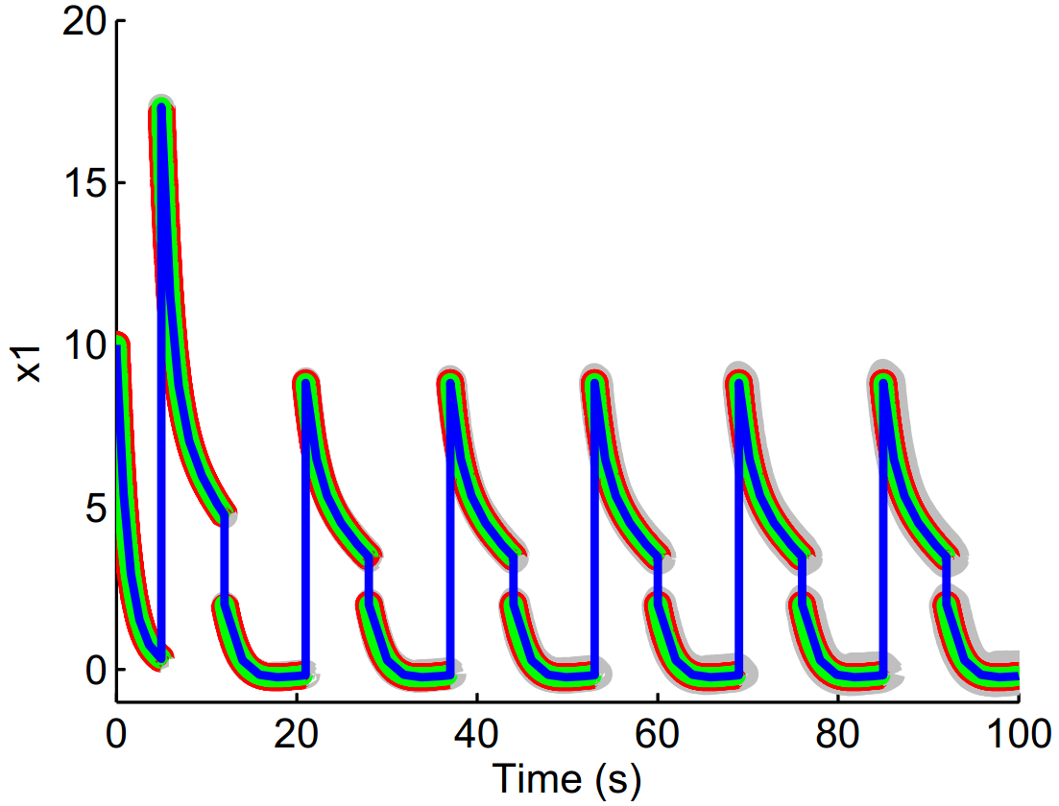
Corrected Semantics Mismatch
SpaceEx’s LGG
SpaceEx's STC
Flow*
SLSF
Add auxiliary variables to store intermediate values of the variables in the translation!

Slide 21
HyST: History of Hybrid Systems Verification Tools
HSIF: Hybrid Systems Interchange Format [Pinto et al, HSCC 2005], outcome of DARPA MoBIES and other projects (Charon, d/dt, HyTech, Checkmate, …)
CIF: Compositional Interchange Format for Hybrid Systems [van Beek et al, HSCC 2007]
Libraries for parsers even available! http://cif.se.wtb.tue.nl/
Problems with common formats (as usual):
Possible semantics differences and edge cases (see UML, Statecharts, C, …); may vs. must, urgency vs. not, …
Laziness, funding motivations, paper writing (“new” tools), etc.
Existing interchange formats not known to many or forgotten (very unfortunate)
Other options: Simulink/Stateflow, Modelica, Ptolemy, some AADL variants (UML), ...
Recent research status and tools
Flow*, dReach, SpaceEx, HyCreate, C2E2, probably many other tools use hybrid automata
Same semantics (hybrid automata and executions thereof), but different syntax!
In my view, worst possible scenario
Poor graduate students (e.g., recently me) have to translate by hand examples between tools for papers
Or, ambitious ones hack scripts to translate from one tool to another (e.g., in Passel…)
All of this can be done (nicely) within HyST, and reduces the chances for bugs (extensive unit/regression testing framework setup)
Some approaches, e.g., parameterized networks in Passel (and many different semantics for networks in general) or stochastic hybrid systems, require more general semantics, but most recent approaches target hybrid automata, and work is underway
Exceptions are most recent theorem-proving approaches (in PVS, Isabelle, and KeyMaera) due to expressiveness

Slide 22
HyST Vision
“SMT-LIB” or “llvm” for hybrid systems
Short-term: implementation framework for source-to-source translation, benchmark generators, etc.
Find and fix bugs (especially soundness ones) in CPS development tools (NSF CCF/SHF AIDE-CPS project)
Midterm vision: Output interchange formats: common reachable set representations and comparisons
Longer-term vision: objective comparisons between algorithms, data structures, symbolic state representations, etc., so we can get to the status in verification of continuous/hybrid systems where we are at in numerical analysis/simulation of such systems (e.g., see Simulink/Stateflow) and hardware verification (e.g., Cadence/Synopsys)

Slide 23
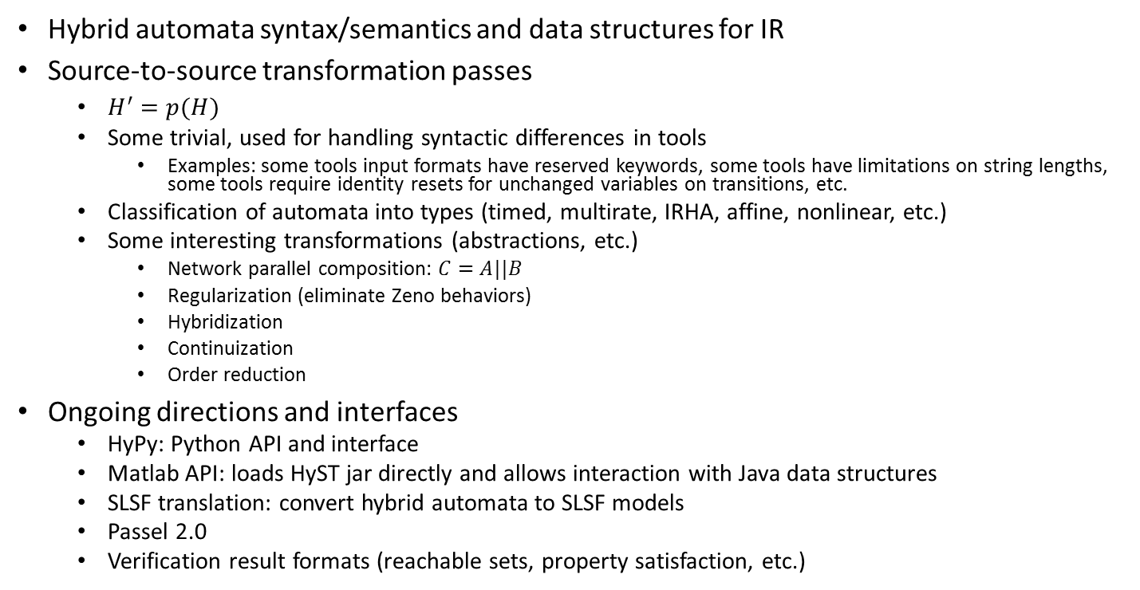
HyST Overview and Outline for Remainder
Hybrid automata syntax/semantics and data structures for IR
Source-to-source transformation passes
$H^{′}=p(H)$
Some trivial, used for handling syntactic differences in tools
Examples: some tools input formats have reserved keywords, some tools have limitations on string lengths, some tools require identity resets for unchanged variables on transitions, etc.
Classification of automata into types (timed, multirate, IRHA, affine, nonlinear, etc.)
Some interesting transformations (abstractions, etc.)
Network parallel composition: $C=A||B$
Regularization (eliminate Zeno behaviors)
Hybridization
Continuization
Order reduction
Ongoing directions and interfaces
HyPy: Python API and interface
Matlab API: loads HyST jar directly and allows interaction with Java data structures
SLSF translation: convert hybrid automata to SLSF models
Passel 2.0
Verification result formats (reachable sets, property satisfaction, etc.)

Slide 24
Hybrid Automata: Syntax, Semantics, and Data Structures for Intermediate Representation (IR)

Slide 25
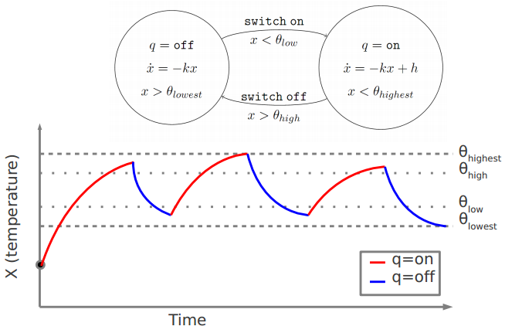
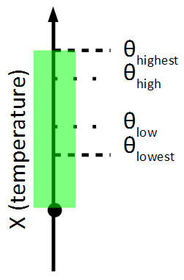
Hybrid Systems and Hybrid Automata
Model for mixed continuous/discrete behaviors
Simulation
Reachability

Slide 26
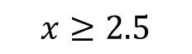
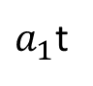
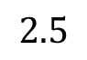
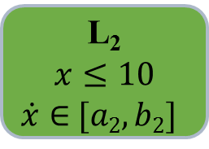
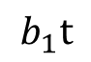
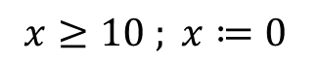
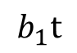
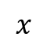
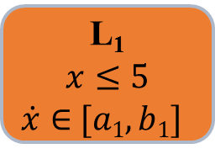
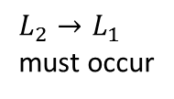
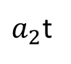









Hybrid Automaton Example
$$x≥2.5$$
$$x≔\text{0}$$
L₁
$$x≤5$$
$\dot{x}∈$ $[a1,b1]$
L₂
$$x≤10$$
$\dot{x}∈$ $[a2,b2]$
$L_{1}→L_{2}$
may occur
$L_{1}→L_{2}$
must occur
$$x≥10 ; x≔\text{0}$$
$$x$$
$L_{2}→L_{1}$
must occur
$L_{1}→L_{2}$
may occur
$$10$$
$$b_{2}t$$
$$5$$
$a_{2}$t
$$2.5$$
$$b_{1}t$$
$$b_{1}t$$
$a_{1}$t
$a_{1}$t
time ($t$)

Slide 27


Hybrid Automata: Syntax and Semantics
A hybrid automaton (HA) H is a tuple:
$$H ≜〈Loc, Var, Inv, Flow, Trans, Init〉$$
Loc: a finite set of discrete locations
Var: a finite set of n real-valued variables
Inv: a finite set of invariants, one for each location; predicates over Var that must be satisfied for real-time to elapse
Flow: a differential inclusion, which is a predicate over $Var$ and $\dot{Var}$ (e.g., $\dot{x}∈F(x)$)
Trans: a finite set of transitions between locations
Guard: a predicate over Var, which is an enabling condition that must be true so that this transition may be taken
Update: a predicate over Var and Var’, which updates variable values if this transition is taken
Init: a predicate over Var that describes a set of initial states
The state space is $Q≜Loc×ℝ^{n}$
There is a continuous trajectory $τ≜〈q,q^{′}〉∈C$ for $C⊆Q×Q$ iff there exists $δ∈ℝ$ such that, for all $0≤ε≤δ$, $f\left(ε\right)⊨Inv$, where $\dot{f}\left(ε\right)∈Flow$, and $q^{′}=f\left(δ\right)$
There is a discrete transition $τ≜〈q,q^{′}〉∈D$ for $D⊆Q×Q$ iff $q⊨Guard$ and $q^{′}∈Update$
The transition relation $T⊆Q×Q$ is composed of discrete transitions and continuous trajectories, $T≜D∪C$
An execution of H is a sequence:
$α≜q_{0}→q_{1}→q_{2}→…$
$q_{0}∈$ $Q_{0}$, where $q_{0}⊨Init$
$q_{i}→q_{i+1}$ is $〈q_{i},q_{i+1}〉∈Q$ and is either a discrete transition (in D) or a continuous trajectory (in C)
$q_{k}$ is reachable in k steps from $q_{0}$ iff there exists an execution $α≜q_{0}→q_{1}→…→q_{k}$

Slide 28

Data Structures for Hybrid Automata
public abstract class Component
public ArrayList <String> variables = new ArrayList <String>();
…
}
public class BaseComponent extends Component {
public LinkedHashMap <String, AutomatonMode> modes = new LinkedHashMap <String, AutomatonMode>();
public ArrayList <AutomatonTransition> transitions = new ArrayList<AutomatonTransition>();
…
}
public class AutomatonMode {
public Expression invariant;
public LinkedHashMap <String, ExpressionInterval> flowDynamics;
…
}
Formal definition:
$$H ≜〈Loc, Var, Inv, Flow, Trans, Init〉$$
Data structures, e.g., objects in Java
H is a class (e.g., HybridAutomaton), with fields:
Var is a set of variable names
Loc is a set, where each l in Loc is a class with:
l.Inv is an expression over Var
l.Flow is an expression over Var and $\dot{Var}$
l.Trans is a set, where each t in Loc.Trans is:
t.Guard is an expression over Var
t.Update is an expression over Var and Var’
Init is a set of initial conditions, each of which is a pair consisting of a location and an expression over Var
HyST uses instantiations of such classes as the intermediate representation
Standard symbolic representation of states
Expressions: represented essentially by an abstract syntax tree (AST)
Many transformations (simplifications, etc.)
Hook ups to Z3 for SAT checking and basic static analysis
Examples: invariants and guards do not intersect
Networks of automata
Represented by sets of HybridAutomaton objects
Some technicalities: semantics of parallel compositions of automata ($A||B$) vary, labels vs not, etc.

Slide 29


Comparing Verification Tools with HyST

Slide 30


HyST Neuron Example
Flow*
HyCreate with Pseudo-Invariants

Slide 31
Transformation Passes

Slide 32
HyST Model Transformation Passes
Automated abstractions
Pseudo invariants
Continuzation
Abstract a hybrid automaton with a purely continuous system
[Bak and Johnson, RTSS 2015]
Hybridization
Abstract nonlinear dynamics with a hybrid automaton with linear dynamics
[Bak, Bogomolov, Henzinger, Johnson, Prakash (in review)]
http://verivital.com/hyst/pass-hybridization/
Order reduction
Reduce dimensionality of a hybrid automaton
[Tran, Nguyen, Xiang, Johnson (in review)]
http://verivital.com/hyst/pass-order-reduction/

Slide 33
HyST User Interaction for Passes
java -jar Hyst.jar -h
Available Model Transformation Passes:
-pass_identity Add Identity Resets Pass [no param]
-pass_pi Pseudo-Invariant at Point Pass [(modename|)pt1;inv_dir1|pt2;inv_dir2|...] (point/invariant direction is a comma-separated list of reals)
-pass_pi_sim Pseudo-Invariant Simulation Pass [time1;time2;...]
-pass_scale_time Scale Time Pass [multiplier;ignorevar]
-pass_sub_constants Substitute Named Constants for Values Pass [no param]
-pass_simplify Simplify Expressions Pass [no param]
-pass_split_disjunctions (print) Split Guards with Disjunctions if the param 'print' is given, any disjunctions that are split will be printed.
-pass_remove_unsat Remove Unsatisfiable Modes Pass [no param]
-shorten Shorten Mode Names Pass [no param]
-regularize Regularization (eliminate zeno behaviors) Pass [<num jumps>;<delta>]
-continuize Continuization Pass -bloats VAL1 VAL2

Slide 34
Example Transformation Pass: Add Identity Resets to Heater (Lygeros)
java -jar Hyst.jar ..\examples\demo\heaterLygeros.xml -pass_identity 0 -spaceex
Before Pass
<transition source="1" target="2">
<guard>x &lt;= 18.1</guard>
<labelposition x="-31.0" y="3.0" width="76.0" height="50.0" />
<middlepoint x="579.0" y="381.5" />
</transition>
<transition source="2" target="1">
<guard>x &gt;= 29 </guard>
<labelposition x="-38.0" y="-52.0" width="78.0" height="50.0" />
<middlepoint x="591.0" y="261.5" />
</transition>
After Pass
<transition asap="false" bezier="false" source="1" target="2" timedriven="false">
<guard>x &lt;= 18.1</guard>
<assignment>x' == x &amp;
t' == t</assignment>
<labelposition/>
<middlepoint/>
</transition>
<transition asap="false" bezier="false" source="2" target="1" timedriven="false">
<guard>x &gt;= 29</guard>
<assignment>x' == x &amp;
t' == t</assignment>
<labelposition/>
<middlepoint/>
</transition>

Slide 35


Example Transformation Pass: Add Identity Resets to Heater (Lygeros)
java -jar Hyst.jar ..\examples\demo\heaterLygeros.xml -pass_identity 0 -spaceex > ..\examples\demo\heaterLygeros_identity.xml
Before Pass
After Pass

Slide 36



Continuization Pass

Slide 37
Continuization
Approximate a quickly-switching discrete system by a continuous system with bounded noise (nondeterminism)
Previously used to analyze properties about hardware circuits (phase-locked loops)
Key challenge: how much nondeterminism?
“Formal Verification of Phase-Locked Loops using Reachability Analysis and Continuization”, Althoff et al., CACM 2013

Slide 38
Verification
Reachability is important for verification
Reachable
States
Initial
States
Unsafe
States

Slide 39
Verification
Reachability accuracy is important for verification
Reachable
States
Initial
States
Unsafe
States
Overapproximation of
Reachable States

Slide 40
Verification
Reachability accuracy is important for verification
Reachable
States
Initial
States
Unsafe
States
Overapproximation of
Reachable States

Slide 41




Flowpipe Construction
Flowpipe construction explores the reachable states symbolically
Continuous Post
Discrete Post
X (temperature)
Post_{C}
Post_{C}
Post_{C}
Post_{C}
…
Intersection
Intersection
Intersection
Computation Steps

Slide 42


Continuous Post
Track sets of states at different instants in time
Continuous Post Operation

Slide 43
Intersection
Tracked states get overapproximated when performing intersection operations
Typically adds some error
Overapproximation for Intersection

Slide 44


Periodic Control System Models
Apply a digital controller to a physical system
Depending on the implementation, different hybrid automaton representation
Strictly Periodic
Real-time Scheduled*

Slide 45
Periodic Control System Reachability
Reachability tools experience error on each discrete transition
Periodic control systems have lots of discrete transitions
Controller may run tens or hundreds of times per second

Slide 46

Example
Simple 1-d system: point moving along a line
x’= vel vel’ = accel (accel set by PD-controller)
Controlled at 200 Hz (T=0.005)
Reachability from x=[0,0.1]
“SpaceEx: Scalable Verification of Hybrid Systems ”, Frehse et al., CAV 2011
“Flow*: An Analyzer for Non-Linear Hybrid Systems”, Chen et al., CAV 2013

Slide 47
Continuization of a Sine Wave
controller_update(t) = sin(t)
t in [0, π]
Controller period, T = 0.2

Slide 48
Process for Sine Wave Example
Derivative of sin(t) is cos(t)
Bound on cos(t) from 0 to π is K=[-1, 1]
Maximum deviation is [-T, 0] * K = [-0.2, 0] * [-1, 1] = [-0.2, 0.2]

Slide 49

Local Analysis Domains - Example
Bound in each domain is [-T, 0] * K_{i}
Domains overlap by T = 0.2 (why?)

Slide 50
Observations
Accuracy can be improved either through local analysis domains, or by considering smaller periods (multiply by [-T, 0])
Contrast with reachability of direct models
Intuitively, sampling at a higher frequency more closely matches the continuous system
Trade-off of analysis domains versus number of discrete transitions (time-triggered support)
The continuized system also accounts for variations from real-time scheduling

Slide 51

Point-Line Example

Slide 52
Finding K
Process is :
(1) symbolic derivative
(2) compute bounds K in each domain
(3) multiply [-T, 0] * K
Step (2) can be tricky, since if the domain is wrong, the bounds will be wrong.

Slide 53
Derivative Range
To compute the range of the derivative, you might need to know the range of the derivative
Chicken and egg problem
Example: In the point-line system, the continuous approximation has:
a' = -10*v – 3 * a
Question: In time [0,10], what is the range of a'?

Slide 54
Range Checks
Solution: guess and check
Assume the real range is close to the simulated range (add bloating term)
Add reachability-time checks if the ranges are wrong to error modes
If no error modes are reached, then the ranges are correct

Slide 55
Hyst Implementation
Continuization was implemented in the Hyst model transformation tool. Input is:
Hybrid Automaton Model Description File
Maximum Controller Inter-Sample Time, T
Periodically-Controlled Variable Name
Times for Analysis Domains
Bloating Terms for Analysis Domains
Time Variable Name (optional)

Slide 56

Yaw-Damper for a 747 Aircraft
Case study from Matlab control systems toolbox
LTI dynamics, MIMO system
2 inputs (rudder, aileron); 2 outputs (yaw rate, bank angle); 5 internal states (sideslip angle, yaw rate, roll rate, bank angle, and washout filter variable)
Control goal: prevent oscillations while maintaining spiral mode in aileron-to-bank angle impulse response
“Yaw Damper Design for a 747® Jet Aircraft” http://www.mathworks.com/help/control/examples/yaw-damper-design-for-a-747-jet-aircraft.html

Slide 57


Yaw-Damper Direct Reachability
The spiral mode is the apparent offset in the steady-state in the aileron-to-bank angle impulse response
We analyze a real-time scheduled periodic version of this model running at T=0.05 (20Hz)

Slide 58

Yaw-Damper with Continuization

Slide 59

Hybridization

Slide 60


Another Model Transformation: Pseudo-Invariants
Pseudo-invariants improve reachability computation by splitting a mode in a hybrid automaton
converted to
"Reducing the Wrapping Effect in Flowpipe Construction using Pseudo-Invariants (Work-in-Progress)", S. Bak, Fourth Workshop on Design, Modeling and Evaluation of Cyber Physical Systems (CyPhy 2014)
Notes:
60

Slide 61

Van der Pol Dynamics
Notes:
61

Slide 62
Flow-pipe computation
Notes:
62

Slide 63

Flow-pipes with Pseudo-Invariant
Notes:
63

Slide 64
Computing Reachability
Using Flow*, a reachability tool that uses Taylor Models as a state-set representation, we ran the following two models (initial state: x = 1.0, y=[-0.5, 0.5]):
first { poly ode 1 {
x'= y
y'= y - x - x^2 * y
}
inv { x in [0.75, 999] } }
second { poly ode 1 {
x'= y
y'= y - x - x^2 * y
}
inv {}}
jumps { first -> second
guard { x in [-999,0.75] }
reset { }
parallelotope aggregation {}}
poly ode 1 {
x'= y
y'= y - x - x^2 * y
}
Error gets too large at t=1.54, tool exits
Completes
Successfully!
Notes:
64

Slide 65

Flow* Reachability
Notes:
65

Slide 66




CASE STUDY
VERIFICATION FOR BUILDING MODEL
Model of Los Angeles University Hospital
Full order system $M_{48}$ has 48 state variables
Initial condition
Output need to be observed
Safety specification for full order system
Under 1-radian step disturbance input u and the initial condition $X_{0}$,
The output y satisfies:
Verification problem

Slide 67

CASE STUDY
VERIFICATION FOR BUILDING MODEL
Verification using 10-order output abstraction
The transformed safety specification of

Slide 68

CASE STUDY 1
VERIFICATION FOR BUILDING MODEL
Verification using 10-order output abstraction

Slide 69
Ongoing directions: AIDE-CPS
Automating Improvement of Development Environments for Cyber-Physical Systems

Slide 70
Differential Testing Framework with HyST
Random generation
(HyRG)
SAT
A_{R}
Model translation
(HyST)
A_{S}
A_{F}
A_{D}
A_{H}
A_{SF}
A_{O}
SpaceEx
Flow*
dReach
HyCreate
SLSF
Other Tools
Execute a random model on different tools
Reach, Trace
Compare analysis results by calling reachCheck
UNSAT
Report a candidate bug

Slide 71

Finding Soundness Bugs
dReach soundness bug found with HySt: dReach returns that reaching a state along the blue line (goal states) from an initial condition indicated by the red point is not possible for the Van der Pol oscillator system, while it is

Slide 72





Translation to SLSF and Subsequent Code Generation
SpaceEx XML
$$N=P||C$$
Plant (Hybrid Automaton), P
HyST Intermediate Representation (IR)
(Networks of hybrid automata)
$$\hat{N}=\hat{P}||\hat{C}$$
Controller
(Purely Discrete Automaton), C
Simulink/ Stateflow
Code Generation
Physical Plant and Actual Controller

Slide 73
Ad: 3rd International Workshop on Applied Verification for Continuous and Hybrid Systems (ARCH), CPSWeek 2016 in Vienna
Verification of continuous and hybrid systems is increasing in importance due to new cyber-physical systems that are safety- or operation-critical. This workshop addresses verification techniques for continuous and hybrid systems with a special focus on the transfer from theory to practice.
Topics include, but are not limited to
Proposals for new benchmark problems (not necessarily yet solvable)
Tool presentations
Tool executions and evaluations based on past ARCH benchmarks
Experience reports including open issues for industrial success
http://cps-vo.org/group/ARCH/
The paper with the most promising benchmark results receives a prize of 500 Euros sponsored by Robert Bosch GmbH, Germany. The winner is preselected by the program committee and determined by an audience voting.
Submission deadline: mid-February, 2016

Slide 74

ARCH 2016 HyST Tool for Executable Benchmarks
ARCH contributors (and anyone) may use/contribute to our Hyst tool (joint work with Stanley Bak and Sergiy Bogomolov): http://verivital.com/hyst/ https://github.com/verivital/hyst
Large benchmark suite and scripts to batch tool runs
Automated abstractions: hybridization, continuization, order reduction, etc.
Goal: standardized formats and objective verification tool/method comparisons for hybrid systems

Slide 75



Thank You! Questions?
HyST: Source Translation and Transformation for Hybrid Automata, Stanley Bak, Sergiy Bogomolov, Taylor Johnson
Acknowledgements
Christian Schilling, Pradyot Prakash
UTA CSE: Luan Viet Nguyen (PhD), Hoang-Dung Tran (PhD), Mousa Almotairi (PhD), Nathan Hervey (MSc)
UTA EE: Omar Beg (PhD)
Taylor T. Johnson
http://www.TaylorTJohnson.com/

Slide 76
Extra Slides

Slide 77


HyST: A Transformation and Translation Tool for Hybrid Systems
dReach
Model Transformation Passes
SpaceEx XML Hybrid
Automaton Network
HyComp
(nuXmv)
HyST Intermediate Representation
$$H$$
$$P$$
QBMC in Python
HyST is available: http://verivital.com/hyst/
QBMC implementation & examples are available online at:
http://www.verivital.com/hyst/cfv2015.zip
Simulink / Stateflow
Other tools
(Flow*, SpaceEx, …)
[Bak, Bogomolov, and Johnson, HSCC 2015]

Slide 78
BMC for Hybrid Automata
Quantifier-Free BMC for Hybrid Automata
dRreach uses the dReal SMT solver
HyComp built on top of nuXmv that uses the MathSAT SMT solver
Other verification and reachability tools: Uppaal, HyTech, SpaceEx, Flow*, etc.
Quantified BMC for Hybrid Automata
New encoding in our work
Builds on BMC for discrete systems using QBF solvers instead of SAT/SMT solvers
k =0
BMC
(H,k,P)
k ++
SMT Solvers
SAT
Counter-example
UNSAT

Slide 79

Quantifier-Free BMC for RHA
Encoding reachable states in k steps:
$$Reach\left(k\right)≜Init\left(V_{0}\right)∧\bigwedge_{m=0}^{k−1}{T(V_{m},V_{m+1})}$$
$V_{m}$: set of variables, Var, at step m syntactically renamed, e.g., suffix ‘_m’ appended: x $⇒$ x_m
Special variables l and l’ to track locations (Loc)
$T\left(V_{m},V_{m+1}\right)≜D\left(V_{m},V_{m+1}\right)∨C(V_{m},V_{m+1})$
Check P at step k:
$$BMC\left(P,k\right)≜Init\left(V_{0}\right)∧\bigwedge_{m=0}^{k−1}{T\left(V_{m},V_{m+1}\right)}∧P(V_{k})$$
$$BMC\left(P,k\right)≜Reach\left(k\right)∧P(V_{k})$$
Correctness: H reaches state satisfying P at step k iff $BMC\left(P,k\right)$ is SAT

Slide 80

Quantified BMC for RHA
Encoding reachable states in k steps:
Quantifier-free: $Reach\left(k\right)≜Init\left(V_{0}\right)∧\bigwedge_{m=0}^{k−1}{T\left(V_{m},V_{m+1}\right)}$
Quantified:
$$QReach\left(k\right)≜∃V_{0},…,V_{k},δ,∀s,∃V,V^{′} | Init\left(V_{0}\right)∧T\left(V,V^{′}\right)∧$$
$\bigwedge_{m=0}^{k−1}{s_{m+1}⇒[\left(V=V_{m}\right)∧\left(V^{′}=V_{m+1}\right)]}$
$V_{m}$: Var at step m syntactically renamed, e.g., suffix of ‘_m’ appended: x $⇒$ x_m
$T\left(V_{m},V_{m+1}\right)≜D\left(V_{m},V_{m+1}\right)∨C(V_{m},V_{m+1})$
s$\text{ = }〈s1,s2,…,s_{\left\lceil \log_{2}k\right\rceil }〉$: a bitvector to index each step 0,…,k
$δ$ is a real that encodes real-time elapse
Technical note: universal quantifier $∀ε$ used to define semantics of invariants not necessary for RHA due to monotonicity of flows and convexity of all predicates
Check P at step k:
$$QBMC\left(P,k\right)≜QReach(k)∧P(V_{k})$$
Correctness: H reaches state satisfying P at step k iff $QBMC\left(P,k\right)$ is SAT

Slide 81
Quantifier-Free BMC for RHA
Encoding reachable states in k steps:
$$Reach\left(k\right)≜Init\left(V_{0}\right)∧\bigwedge_{m=0}^{k−1}{T(V_{m},V_{m+1})}$$
$V_{m}$: set of variables, Var, at step m syntactically renamed, e.g., suffix ‘_m’ appended: x $⇒$ x_m
Special variables l and l’ to track locations (Loc)
$T\left(V_{m},V_{m+1}\right)≜D\left(V_{m},V_{m+1}\right)∨C(V_{m},V_{m+1})$
Check P at step k:
$$BMC\left(P,k\right)≜Init\left(V_{0}\right)∧\bigwedge_{m=0}^{k−1}{T\left(V_{m},V_{m+1}\right)}∧P(V_{k})$$
$$BMC\left(P,k\right)≜Reach\left(k\right)∧P(V_{k})$$
Correctness: H reaches state satisfying P at step k iff $BMC\left(P,k\right)$ is SAT

Slide 82
Quantified BMC for RHA
Encoding reachable states in k steps:
Quantifier-free: $Reach\left(k\right)≜Init\left(V_{0}\right)∧\bigwedge_{m=0}^{k−1}{T\left(V_{m},V_{m+1}\right)}$
Quantified:
$$QReach\left(k\right)≜∃V_{0},…,V_{k},δ,∀s,∃V,V^{′} | Init\left(V_{0}\right)∧T\left(V,V^{′}\right)∧$$
$\bigwedge_{m=0}^{k−1}{s_{m+1}⇒[\left(V=V_{m}\right)∧\left(V^{′}=V_{m+1}\right)]}$
$V_{m}$: Var at step m syntactically renamed, e.g., suffix of ‘_m’ appended: x $⇒$ x_m
$T\left(V_{m},V_{m+1}\right)≜D\left(V_{m},V_{m+1}\right)∨C(V_{m},V_{m+1})$
s$\text{ = }〈s1,s2,…,s_{\left\lceil \log_{2}k\right\rceil }〉$: a bitvector to index each step 0,…,k
$δ$ is a real that encodes real-time elapse
Technical note: universal quantifier $∀ε$ used to define semantics of invariants not necessary for RHA due to monotonicity of flows and convexity of all predicates
Check P at step k:
$$QBMC\left(P,k\right)≜QReach(k)∧P(V_{k})$$
Correctness: H reaches state satisfying P at step k iff $QBMC\left(P,k\right)$ is SAT

Slide 83


Example
$$x≥2.5$$
$$x≔\text{0}$$
L₁
$$x≤5$$
$\dot{x}∈$ $[a1,b1]$
L₂
$$x≤10$$
$\dot{x}∈$ $[a2,b2]$
Quantifier-free BMC formula up to k = 2:
P $≜$ $\bigvee_{m=0}^{k}{¬(locm \text{=} L1 →x_{m}≥2.5) }$
$$x≥10 ; x≔\text{0}$$
BMC(P,2) $≜$ I₀ ∧ ($\text{D}\text{0 }$∧ $C_{0}$) ∧ ($\text{D}\text{1}$∧ $C_{1}$) ∧ $(\text{P}\text{(}\text{V}0$)$\text{∨} \text{P}\text{(}\text{V}1$)$\text{∨} \text{P}\text{(}\text{V}2$))
$k=0$: I₀:= ($l0=L1$ ∧$x0=\text{0)}$
$k=1$ (D₀): ($l0=L1$ ∧$l1=L2 \text{∧} x0≤5 \text{∧} x0≥2.5$ $\text{∧} x1=x0$), infeasible
$k=1\text{ (}C\text{0}$): ($l0=L1 \text{→}$($l1=l0 \text{∧} x0+a1\text{δ}≤x1 \text{∧} x1≤x0+b1\text{δ} \text{∧} x1≤5$)
$k=2$ (D₁): ($l1=L1$ ∧$l2=L2 \text{∧} x1≤5$ $\text{∧} x1≥2.5$ $\text{∧} x2=x1$),
$k=2 \text{(}C\text{1}\text{):}$ ($l1=L1 \text{→ }$($l2=l1 \text{∧} x1+a1\text{δ}≤x2 \text{∧} x2≤x1+b1\text{δ} \text{∧} x2≤5$)

Slide 84


Example
$$x≥2.5$$
$$x≔\text{0}$$
L₁
$$x≤5$$
$\dot{x}∈$ $[a1,b1]$
L₂
$$x≤10$$
$\dot{x}∈$ $[a2,b2]$
Quantified BMC formula up to k = 2:
$$x≥10 ; x≔\text{0}$$
QBMC(P,2) $≜$ $∃\text{V}$₀,$\text{V}$₁ ,$\text{V}$₂ , δ$,∀s1∃\text{V},{\text{V}}^{′}| I\left(V\text{0}\right) \text{∧ }\text{T}\text{(}\text{V}\text{, }\text{V}\text{′)}$
$\text{∧}$ {$¬\text{s}\text{1}$ $\text{→}$ [(V = V$0$) ∧ ${(\text{V}}^{′}$ = V$\text{1}$)]}
$\text{∧}$ {$\text{s}\text{1} \text{→}$ [(V = V$1$) ∧ ${(\text{V}}^{′}$ = V$\text{2}$)]}
$\text{∧}$ {$\text{P}\text{(}\text{V}0$)$\text{∨} \text{P}\text{(}\text{V}1$)$\text{∨} \text{P}\text{(}\text{V}2$)}
$k=0$: I₀:= ($l0=loc1$ ∧$x0=\text{0)}$
$k=1$: $¬\text{s}\text{1}$ $\text{→}$($l0=L1 \text{→}$($l1=l0 \text{∧} x0+a1δ≤x1 \text{∧} x1≤x0+b1\text{δ} \text{∧} x1≤5$))
$k=2$: $\text{s}\text{1 }\text{→}$($l1=L1$ ∧$l2=L2 \text{∧} x1≤5$ $\text{∧} x1≥2.5$ $\text{∧} x2=x1$)

Slide 85

Implementation of QBMC in HyST
Using HyST intermediate representation, constructs transition relation T consisting of discrete transitions D and continuous trajectories C, which is a formula over $V$ and $V^{′}$
Creates quantified formula for reachable states:
$QReach\left(k\right)≜∃V_{0},…,V_{k},δ,∀s,∃V,V^{′} | Init\left(V_{0}\right)∧T\left(V,V^{′}\right)∧\bigwedge_{m=0}^{k−1}{s_{m+1}⇒\left[\left(V=V_{m}\right)∧\left(V^{′}=V_{m+1}\right)\right]}$
Adds conjunct for property at each step m
Uses Microsoft Research Z3 via the Z3 Python API
API features not really necessary, can just create SMT-LIB file

Slide 86











Fischer’s Mutual Exclusion
Bad States ($¬P$):
Number of processes
Variables and Initial Conditions
$x_{i}=0$: real, continuous clock
$q_{i}=rem$: discrete location
$g=⊥$: id of last process to check
Mutual exclusion iff A < B
$$∃i,j∈\left\{1,…,N\right\} | (i≠j∧q_{i}=cs∧q_{j}=cs)$$
rem
$${\dot{x}}_{i}=0$$
Inv: $⊤$
Reset: $g^{′}=0$
Guard:$g=⊥$
Reset: $x_{i}^{′}=0$
cs
$${\dot{x}}_{i}=0$$
Inv: $⊤$
Guard: $g≠i∧x_{i}≥B$
Reset: $x_{i}^{′}=0$
Guard:$g=i∧x_{i}≥B$
Reset: $x_{i}^{′}=0$
try
$${\dot{x}}_{i}=1$$
Inv: $x_{i}≤A$
wait
$${\dot{x}}_{i}=1$$
Inv: $⊤$
Reset: $g^{′}=i∧x_{i}^{′}=0$

Slide 87

Evaluation – Fischer – Runtime

Slide 88
Evaluation – Fischer – Runtime

Slide 89

Evaluation – Fischer – Memory Usage

Slide 90
Evaluation – Fischer – Memory Usage

Slide 91

Lynch-Shavit Mutual Exclusion Protocol (Unsafe)

Slide 92
Future Work
Exploit network structure for distributed CPS modeled as networks of hybrid automata (e.g., Johnson and Mitra, FORMATS 2014)
Check inductive invariance conditions and use k-induction
Broader classes of specifications (temporal operators)
Evaluation to alternative approaches, such as UPPAAL
More general continuous dynamics (linear, nonlinear)
Enhancements in HyST for transition relation manipulation
Additional timed protocol and CPS case studies (SATS air traffic control)

Slide 93
Conclusion
QBMC, a new SMT-based technique that encodes, in a quantified form, the BMC problem for rectangular hybrid automata
Encompasses problem for timed automata
Implemented in publicly available HyST tool
QBMC can solve the BMC problem for typical benchmarks such as Fischer and Lynch-Shavit mutual exclusion protocols
Requires less memory usage compared to stated of the art quantifier-free BMC tools such as dReach and HyComp

Slide 94

Example
$$x≥2.5$$
$$x≔\text{0}$$
L₁
$$x≤5$$
$\dot{x}∈$ $[a1,b1]$
L₂
$$x≤10$$
$\dot{x}∈$ $[a2,b2]$
$$x≥10 ; x≔\text{0}$$

Slide 95

Boolean Satisfiability (SAT)
Given a Boolean Formula in Conjunctive Normal Form (CNF)
Is there an assignment to Boolean variables that makes the formula True?
Example: Ω(x1, x2, x3) $≜$ (x1 ∨ x2) ∧ (x1 ∨ ¬x2 ∨ ¬x3) ∧ (¬x2 ∨ x3)
A $≜$ {x1= 1, x2 = 0, x3 = 1} is SAT assignment
SAT solver: tool to find a SAT assignment
Satisfiability modulo theories (SMT) : generalization of SAT with respect to combinations of background theories
Notes:
where literals are interpreted with respect to a background theory (e.g., linear real arithmetic, nonlinear integer arithmetic, bit-vectors, etc.).

Slide 96

SAT-Based Bounded Model Checking(BMC)
The reachable states in k steps are captured by:
Ω(k) $≜$ I(s₀) ∧ $\bigwedge_{i=0}^{k−1}{\text{T}\text{(}\text{i}\text{, }\text{si}\text{+1)}}$∧ ($\bigvee_{i=0}^{k}{\text{P}\text{(}\text{si}\text{)}}$)
The safety property p is satisfied up to step k iff Ω (k) is unsatisfiable:
initial states
transition relation
safety specification
¬p
¬p
¬p
p
¬p
. . .
s₀
s₁
s₂
s_{k-1}
s_{k}

Slide 97






Example
$$x≥2.5$$
$$x≔\text{0}$$
$$loc1$$
$$x≤5$$
$\dot{x}∈$ $[a1,b1]$
$$loc2$$
$$x≤10$$
$\dot{x}∈$ $[a2,b2]$
$$x≥10 ; x≔\text{0}$$
Timed automata: a₁ = b₁ = a₂ = b₂
Multirate-timed automata: a₁ = b₁ and a₂ = b₂, but possibly a₁ ≠ a₂
Rectangular hybrid automata: Otherwise
Bad States:
P $≜$ $\bigvee_{i=0}^{k}{¬(loci \text{=} loc1 →x≥2.5) }$

Slide 98







Example
$$x≥2.5$$
$$x≔\text{0}$$
$$loc2$$
$$x≤10$$
$\dot{x}∈$ $[a2,b2]$
$$loc1$$
$$x≤5$$
$\dot{x}∈$ $[a1,b1]$
P $≜$ $\bigvee_{i=0}^{k}{¬(loci \text{=} loc1 →x≥2.5) }$
$$x≥10 ; x≔\text{0}$$
Rectangular hybrid automata: a₁ = 0, b₁ = 1, a₂ = 0, b₂ = 2

Slide 99
Example: Fischer’s Protocol
Timed mutual exclusion protocol
4 states: initial, waiting, trying, critical section
1 real-valued clock per process
1 globally shared (atomic) variable, g, ranging over process ids
Process ids: {1, …, n}
Safety property: at most one process is in critical section
g := 0
g ≠ i
exit
init
wait
try
cs
g = 0
t_{i} := 0
t_{i} < 1
t_{i} := 0
g := i
g = i ∧ t_{i} > 1

Slide 100


Fischer Mutual Exclusion Protocol
Safe version A $<$ B
Unsafe version: A $≥$ B
Discrete locations: 4^{N}
Discrete state-spaces: (N + 1)(4N)^{N}
Number of processes
Bad States:
$$∃i,j∈\left\{1,…,N\right\} | (i≠j∧q_{i}=cs∧q_{j}=cs)$$

Slide 101

Lynch-Shavit Mutual Exclusion Protocol
Discrete locations: 9^{N}
Discrete state-spaces: (N + 1)(9N)^{N}
Bad States:
Mahata, Pritha. "Model checking parameterized timed systems." (2005)

Slide 102







Small Aircraft Transportation System Basics
Overhead Geometry and Protocol
Safety Property: aircraft on approach always maintain a safe separation
Cyber
Mode ($Fly$, $Hold$, $App$, $Run$)
Sequence of aircraft
Physical
Motion of aircraft on approach
Distributed
Geographically
List-like sequence data-structure spread across aircraft
Parameterized
$N$ aircraft
$$Fly$$
initiate
landing
protocol
$$Hold$$
start
approach
entry spacing $G$
$$Approach$$
miss
length $L$
land
$$Runway$$
Notes:
1.5min

Slide 103










Part of Aircraft $𝓐_{i}$ Model in SATS
$$Fly$$
$q_{i}∈\{Fly,Hold,App,Run\}$
$x_{i}∈ℝ$: distance from start of approach
${next}_{i}$: id of aircraft ahead of $i$ (if any)
$last$: id of last aircraft to enter $Hold$ (if any)
$$next_{i}:=last$$
$$last ≔i$$
$$x_{i}=L$$
$$for each j∈\{1,…,N\}$$
$if next_{j}=i$
$then next_{j}≔NULL$
$$if last≠i then next_{i}≔last$$
$$last:=i$$
$$x_{i}≔0$$
$$Hold$$
$${\dot{x}}_{i}=0$$
$$x\left[{next}_{i}\right]≥G$$
$$App$$
$${\dot{x}}_{i}∈[v_{L},v_{U}]$$
$$x_{i}≤L$$
$$x_{i}=L$$
$$for each j∈\{1,…,N\}$$
$if next_{j}=i$
$then next_{j}≔NULL$
$$if last=i then last≔NULL$$
$$Run$$
Notes:
2 min
Variables: as indicated. SATS has four variables. X_i models the real-valued position, measured from the entry to the base position. Q_i models the control location. Next_i is the aircraft ahead of I, if any. Last modules the airport management module state and is the last aircraft to enter hold.

Slide 104




















Example Evolution of $𝓐(3)$
$𝓐_{1}$ can
approach
$$𝓐_{1}$$ approaches
$$𝓐_{3}$$ misses
$𝓐_{3}$can
approach
$$Fly$$
$$L$$
$$next_{i}:=last$$
$$last ≔i$$
$$x_{i}=L$$
$$for each j∈\{1,…,N\}$$
$if next_{j}=i$
$then next_{j}≔NULL$
$$if last≠i then next_{i}≔last$$
$$last:=i$$
$$x_{i}≔0$$
$$x_{3}$$
$$≥S$$
$$Hold$$
$${\dot{x}}_{i}=0$$
$$x\left[{next}_{i}\right]≥G$$
$$v_{U}t$$
$$G$$
$$App$$
$${\dot{x}}_{i}∈[v_{L},v_{U}]$$
$$x_{i}≤L$$
$$x_{2}$$
$v_{L}$t
$$x_{1}$$
$$x_{i}=L$$
$$for each j∈\{1,…,N\}$$
$if next_{j}=i$
$then next_{j}≔NULL$
$$if last=i then last≔NULL$$
time ($t$)
$$q$$ | $$\left\langle Hold,App,App\right\rangle$$
$$next$$ | $$\left\langle 2,3,NULL\right\rangle$$
$$last$$ | 1
$$q$$ | $$\left\langle App,App,App\right\rangle$$
$$next$$ | $$\left\langle 2,3,NULL\right\rangle$$
$$last$$ | 1
$$Run$$
$$q$$ | $$\left\langle App,App,Hold\right\rangle$$
$$next$$ | $$\left\langle 2,NULL,1\right\rangle$$
$$last$$ | 3

